Slide 1

Session-2 FDP

Slide 2
7:30–7:45 min: | Inaugural.
7:45-8:25 min: Live demo (measurements in v2.aiori.in) Reference AIORI-Handbook | Showcasing Measurements Through the AIORI Platform Regular ping (Using deployed anchor & zone) Periodic Ping (Using deployed anchor & zone) Traceroute (Using deployed anchor & zone) DNS query (Using deployed anchor) In AIORI-Mobile app: Compare network configuration (Wi‑Fi vs Mobile Data) - Run latency test for pingable targets (e.g., google.com, youtube.com)
8:25-8:45 min: Enrollment + Create assignments + linking queries+ Student Workshop Activities Reference AIORI-Handbook | Faculty side (Faculties Portal): • Enrollment/Register students in the AIORI platform • Create assignments Student side (Students Portal): • Link each query to the assignment • Make the query public for team review Showcasing the DNS in use using whatsmydns.aiori.in.
8:45-9:00 min: | Question & Answers

Slide 3
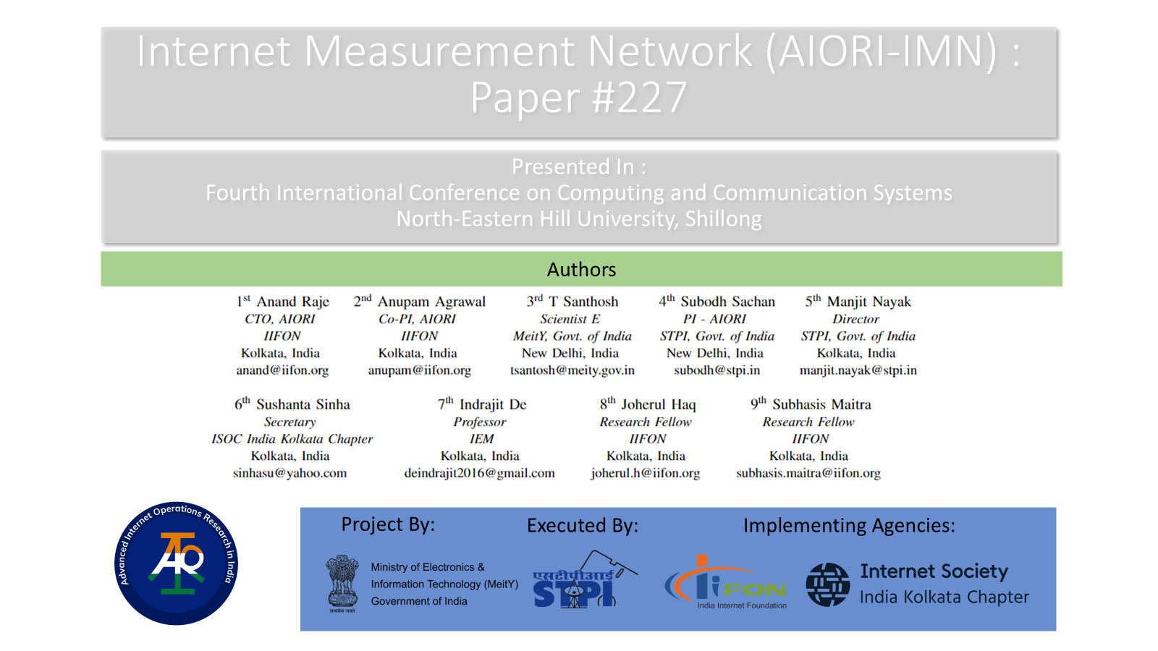
https://ieeexplore.ieee.org/document/10127255

Slide 4
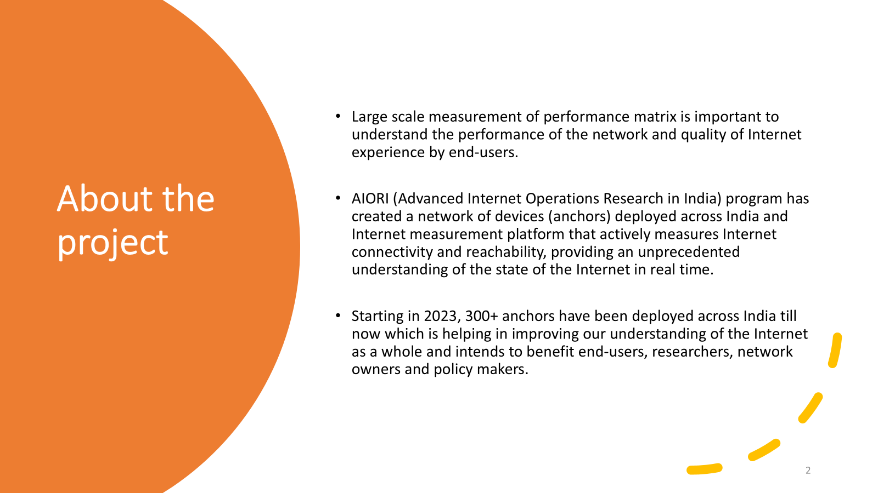

Slide 5
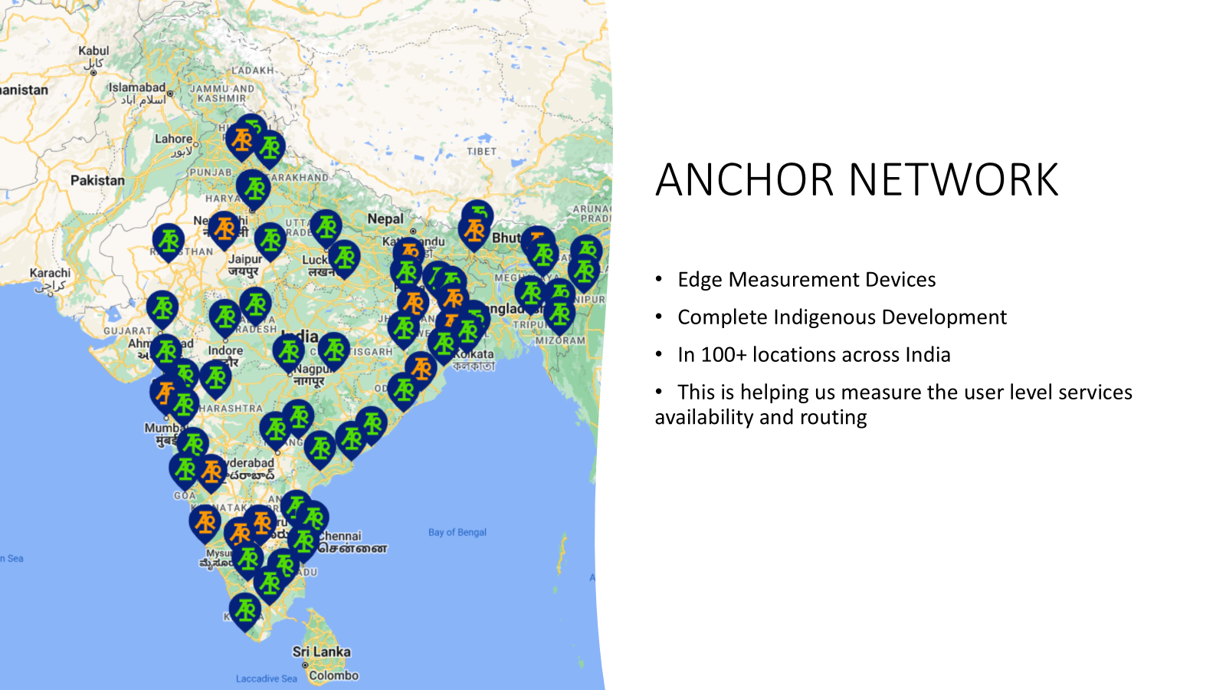

Slide 6


Slide 7

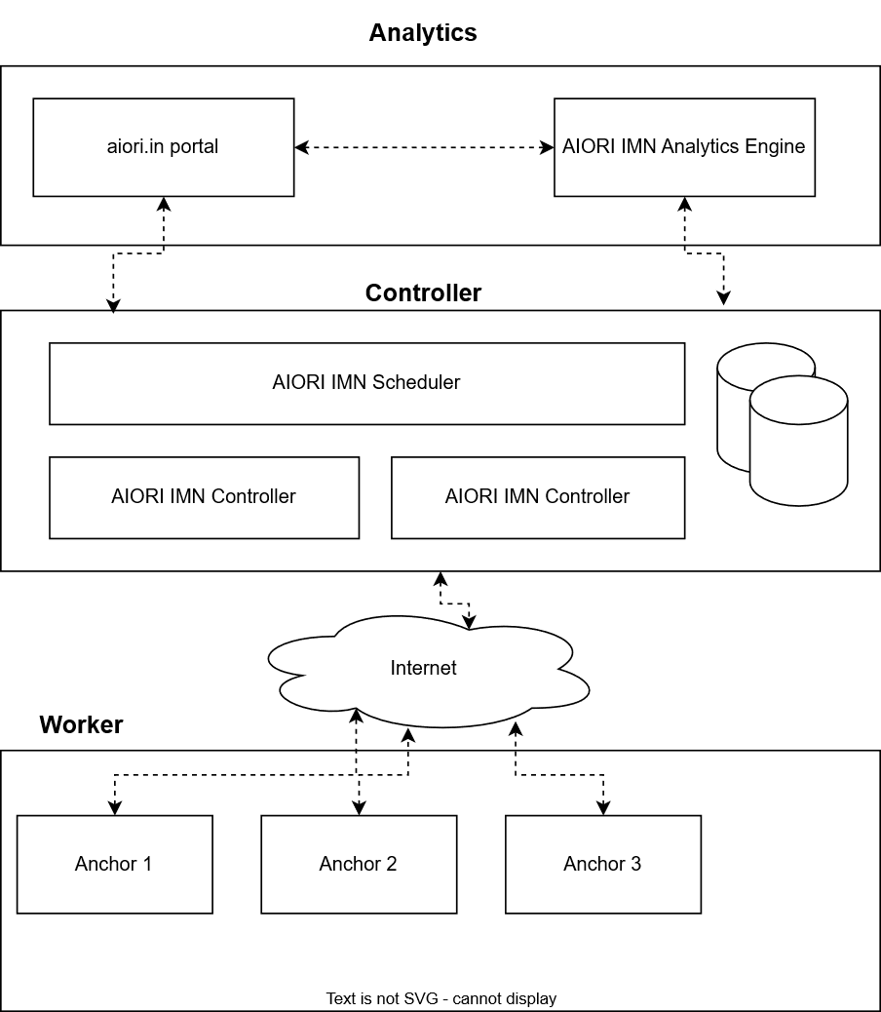
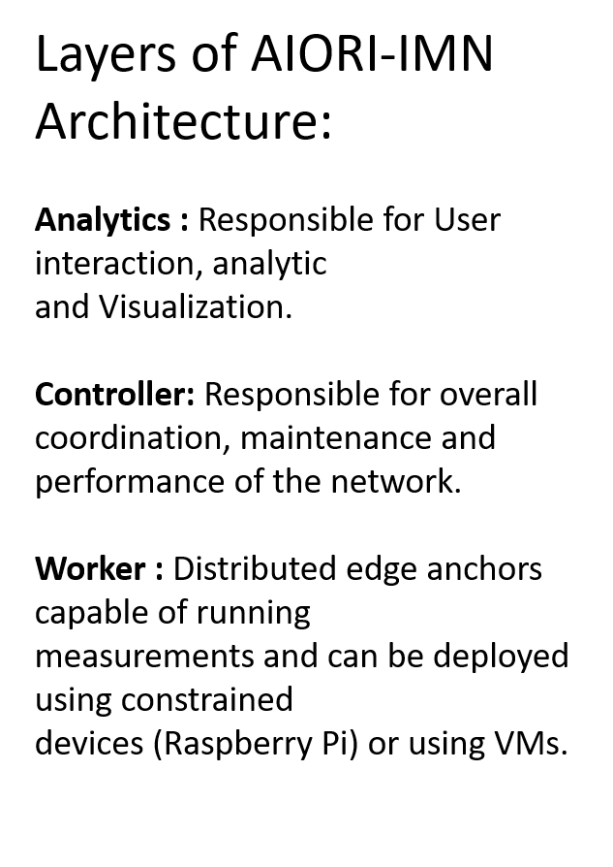

Slide 8
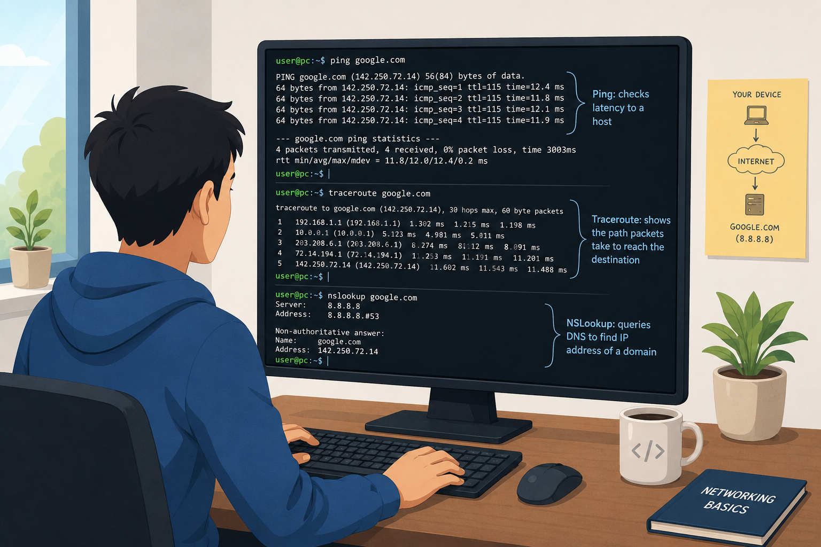

Slide 9
USE CASE 1 :
community driven research
The AIORI portal (https://aiori.in), anycast nodes and anchor management network is an indigenously developed first of its kind took for different stakeholders for Internet measurement.
Anyone can login into the portal( https://v2.aiori.in) and use the network measurement tools to troubleshoot network issues and measure the health.
USE CASE 2 :
Routing Detours
The AIORI Internet Measurement infrastructure will help to analyze the data in transit paths taken when user connects for services from one ASN to another inside the country. This will uncover ASN-to-ASN peering routes as well as help us uncover international routing detours.
USE CASE 3 :
measuring Services Latency
The AIORI Internet Measurement infrastructure will help to analyze the latency of services in different parts of country. This will be useful for government, business to understand the reachability issues of their domains.
USE CASE 4 :
DNS Resiliency from user endpoint
The AIORI Internet Measurement infrastructure will help to analyze the DNS resiliency from use end point in terms of availability and latency of the hierarchy. This will be great tool for resiliency enforcement by different zone maintainers.

Slide 10
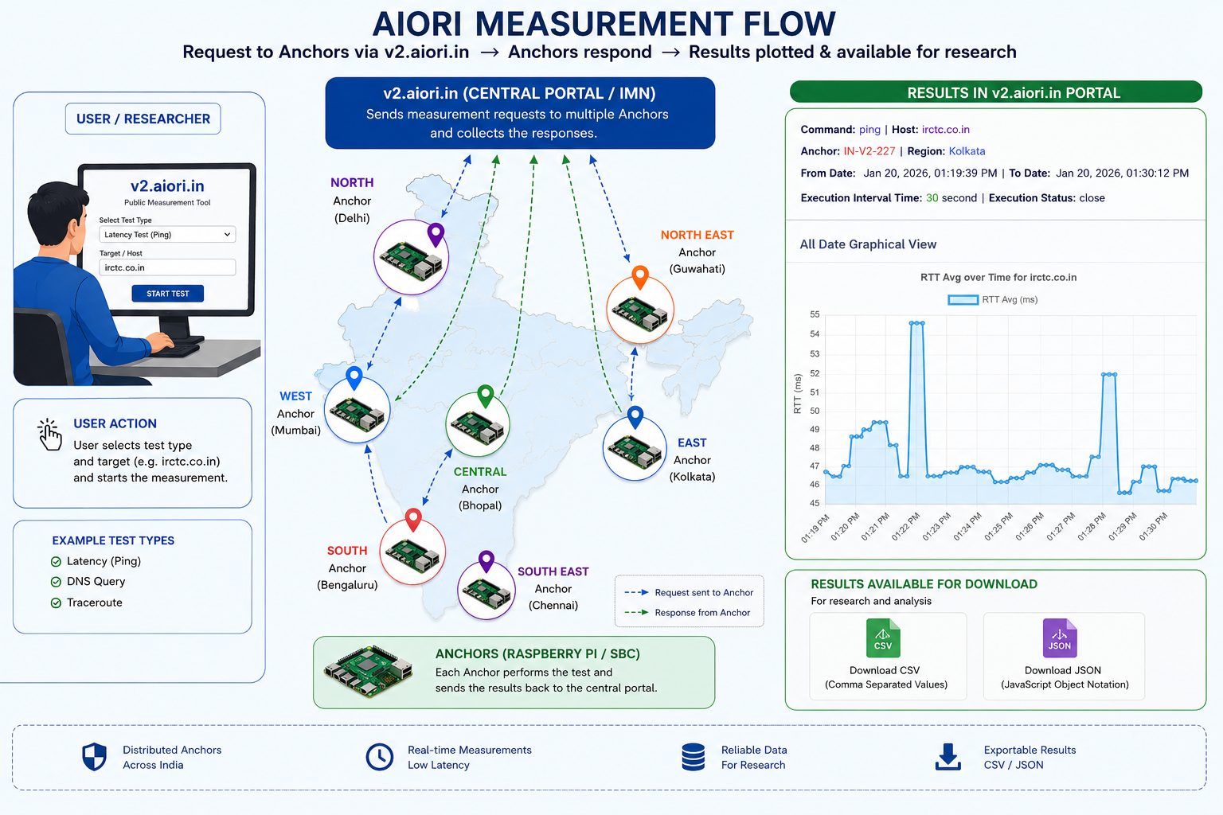

Slide 11
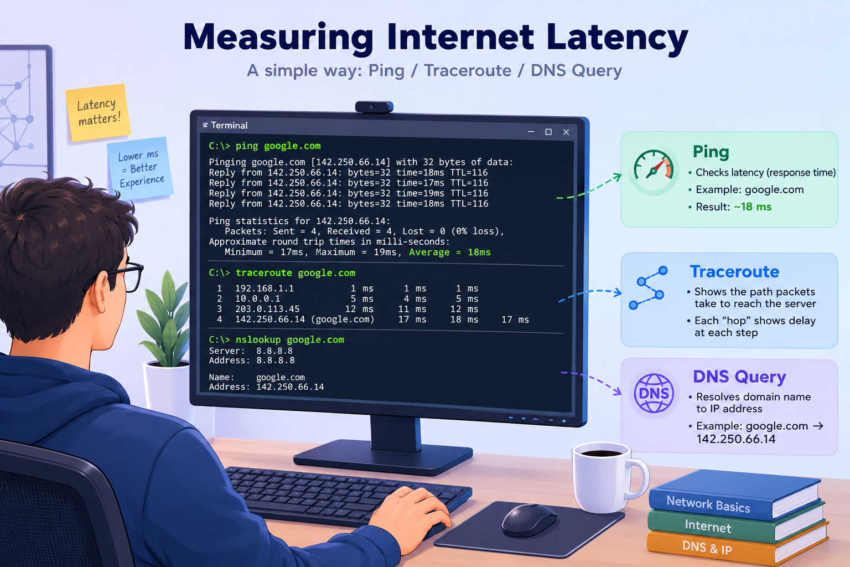
Operation | Windows | Ubuntu/Linux | Purpose
Opens Terminal | Command Prompt / PowerShell | Terminal | Access command-line interface
Ping | ping google.com | ping google.com | Measure network latency (RTT)
Traceroute | tracert google.com | traceroute google.com | Display packet path (network hops)
DNS Query | nslookup google.com | nslookup google.com / dig google.com | Resolve a domain name to an IP address

Slide 12
What needs to be done in the Student Workshop
How the internet functions
AIORI overview (what the platform does + platform tools (aiori.in))
What we measure (how we are measuring through v2.aiori.in)
Benefits of these measurements
Student workshop activities (what students will do)
- Guide students on how to run assigned internet measurement tasks, link the query with assignments and make it public.
- Students will complete the assignment by running the required queries through our applications and submit the results via the Google Form.

Slide 13
What needs to be done in the Student Workshop
Learn AIORI and its purpose (platform overview)
Understand what AIORI is and how the platform supports measurement-driven troubleshooting
See what “anchors” mean and why defined starting points matters
Demonstrate what AIORI measures (latency, DNS, traceroute)
Explain and observe: Latency (experience impact)
Explain and observe: DNS query behavior (name resolution delays)
Explain and observe: Traceroute (route/path indicators)
Analyze & Identify “where the delay is originating”
DNS resolution time
Routing/path-related delays
Decide the next actions based on the evidence

Slide 14
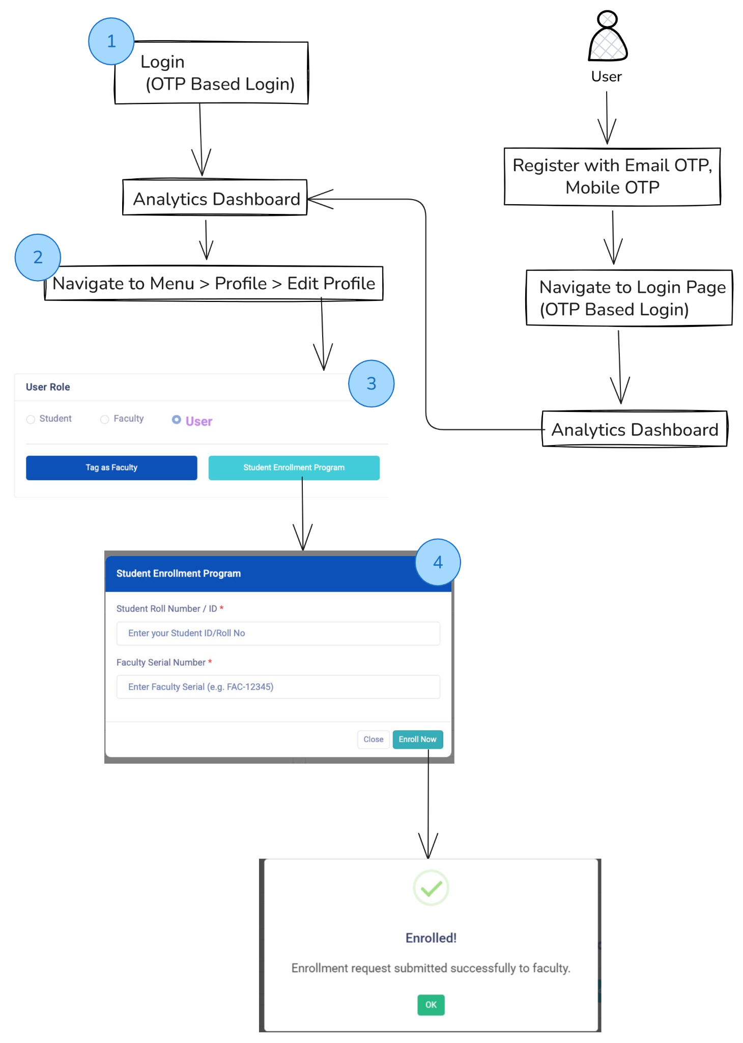
User- Student Enrollment
The student will register and login to v2.aiori.in.
They can navigate to Profile and click Edit Profile.
Next, click the Student Enrollment Program option to open the popup, where the student enters their institutional ID and faculty serial number (FAC-xxxxx) to join under that particular faculty.

Slide 15
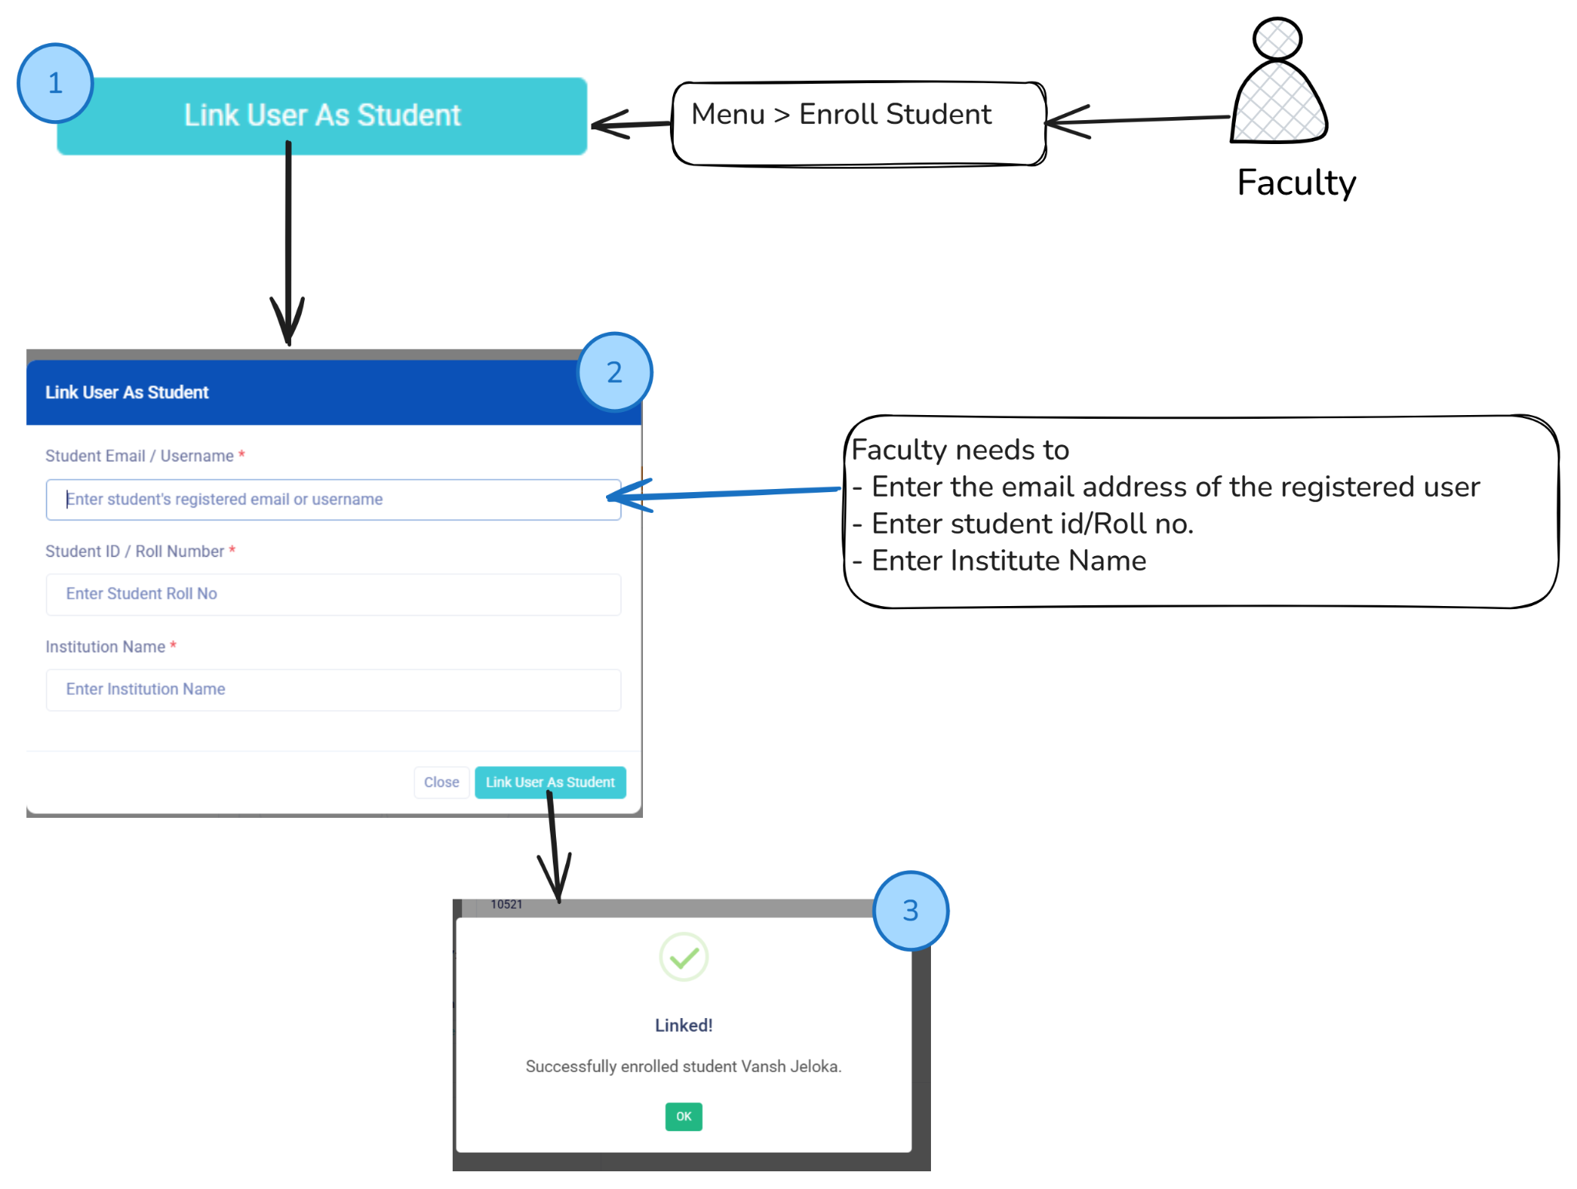
Faculty - Link User as Student
By entering the student’s registered email, institution, and student ID, the faculty can add the user as a student.

