Slide 1

AIORI Standards Hackathon
Timeless Innovators
AIORI-2
HACKATHON 2025 GRAND FINALE
12-13 Nov, 2025

Slide 2
Hackathon Plan
Developing a Post-Quantum DNSSEC testbed under a delegated . IN Domain
RFC 4033 – DNS Security Introduction and Requirements
RFC 4034 – Resource Records for DNSSEC (DNSKEY, RRSIG, DS, NSEC)
RFC 4035 – DNSSEC Protocol Modifications
Design, deploy, and benchmark a PQC-enabled DNSSEC testbed on a delegated .IN subdomain. The testbed will host PQC-signed zones, validate resolution behavior, and provide operational insights for future adoption.
Use PDNS and Unbound for developing Nameservers and Recursive Resolver with PQC-enabled signing and validation in a distributed virtualized architecture.
AIORI-2
Hackathon 2025, Grand Finale

Slide 3






RSA-2048: Breakable by quantum computers in minutes
ECDSA P-256: Vulnerable to Shor's algorithm
Current DNSSEC: 100% dependent on vulnerable algorithms
Timeline: Quantum threat horizon 10-15 years [Q Day]

Slide 4
What got done
Developed a PQ-DNSSEC Testbed simulation with hierarchical trust anchor infrastructure
Create customized nameservers for root delegation with 3LD Zone Signing and verification via NIST standardized PQC Algorithms. [NIST FIPS 204 & 205]
https://github.com/debasmitadutta14/Aiori-Timeless-Innovators
Implemented and tested 3 PQC Algorithms
Established 3-tier architecture
Try testbed: http://14.194.176.204:5000/
AIORI-2
Hackathon 2025, Grand Finale

Slide 5
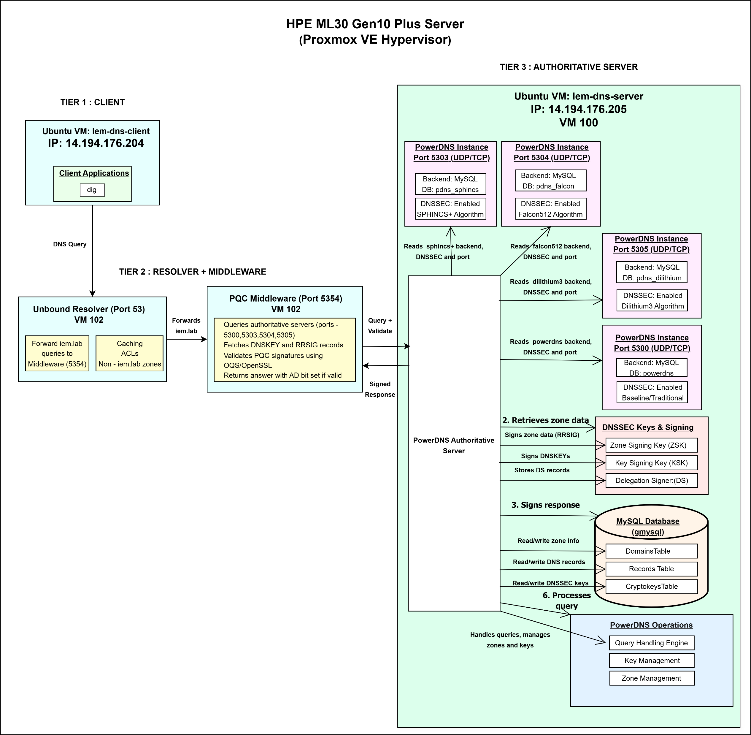
Three-Tier PQC-DNSSEC Architecture

Slide 6
What we learned
PQC signatures cause large packet sizes
Frequent UDP truncation → TCP fallback
EDNS0 buffer tuning is essential
Resolver behaviour varies widely
PQC algorithm performance differs significantly
PQC increases CPU usage on authoritative servers
Shows different behaviour in terms of latency, packet size, and computational overhead.
AIORI-2
Hackathon 2025, Grand Finale

Slide 7
Algorithm | CPU Usage During DNSSEC Ops | Signing Time | Verification Time | Avg Size
ECDSA P-256 | 18–25% CPU | 55–70 µs | 110–140 µs | 72 bytes
Falcon-512 | 32–40% CPU | 85–110 µs | 55–80 µs | 771 bytes
Dilithium-3 | 45–55% CPU | 1.2–1.5 ms | 0.9–1.2 ms | 1,456 bytes
SPHINCS+ (Fast) | 75–90% CPU | 12–18 ms | 6–9 ms | 3,398 bytes

Slide 8
Wrap Up
Team members:
Rajdeep Das
Debasmita Dutta
Prof.(Dr.) Indrajit De
rajdeep.das2025@iem.edu.in
debasmita.dutta@iem.edu.in
indrajit.de@iem.edu.in
AIORI-2
Hackathon 2025, Grand Finale

