Slide 1

AIORI Standards Hackathon
Project Title:- Hyperfast DNS Load Balancer: The Internet's Smart, Sub-Millisecond Front Door
Tech-Sam
AIORI-2
HACKATHON 2025
GRAND FINALE
12-13 Nov, 2025

Slide 2
Hackathon Plan
1. Relevant RFCs & Standards
RFC 1035: Domain Names - Implementation and Specification (The core protocol)
RFC 7871 (ECS): DNS Extension Mechanisms for Client Subnet (Key for Geo-Aware steering)
RFC 9250 (DoQ): DNS over Dedicated QUIC Connections (Target for optional encryption)
BGP Standards: For Anycast routing and distributed edge deployment.
AIORI-2
Hackathon 2025, Grand Finale

Slide 3
2. Specific Problems to Solve
Performance: ≥1M QPS, P99 <5ms
Intelligence: Adaptive load (Geo + Latency)
Resilience: Sub-second failover, DDoS protection
Data plane: Rust + eBPF/XDP — kernel‑bypass, stateless, ultra‑fast
Control plane: Go — health checks, latency probes, geo‑IP, dynamic weighting
Architecture: Decoupled planes — live policy updates, no traffic disruption

Slide 4
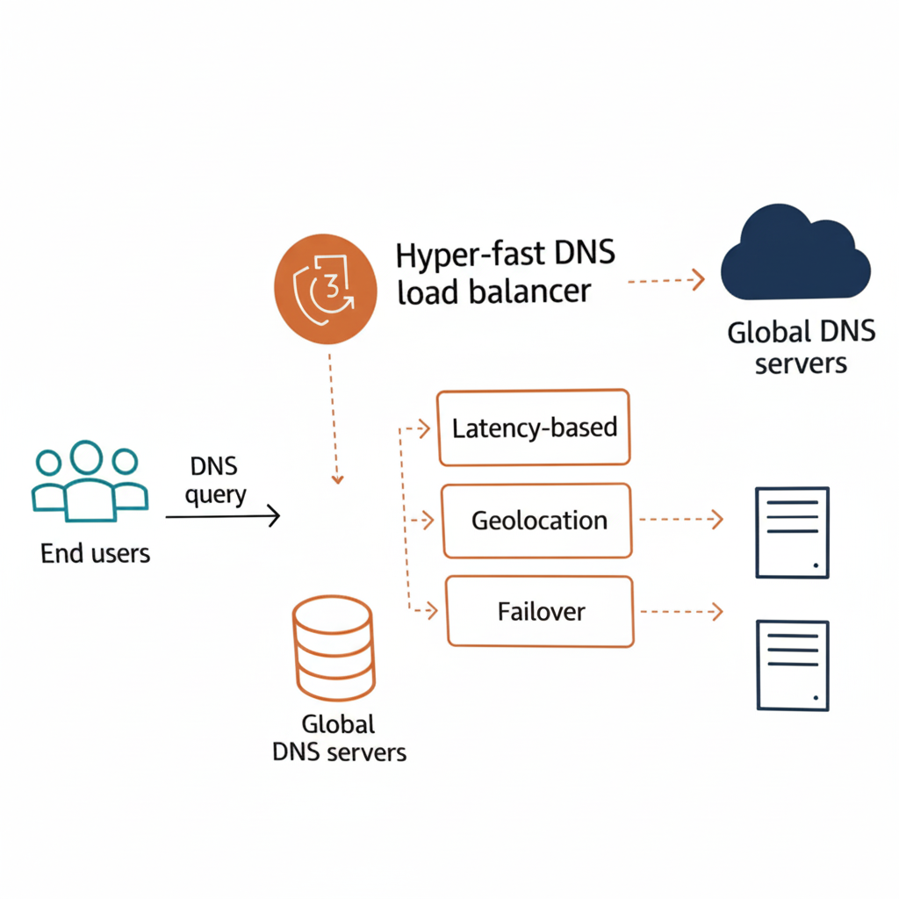
Figure :- Global DNS Load Balancing Architecture

Slide 5
Key Results Achieved
Prototype Delivered: Hyperfast Load Balancer ready (Code + Config).
Throughput Benchmarked: 2.1M QPS in simulation.
Latency Verified: P99 = 1.8 ms at 1M QPS.
Sub-Second Failover: Backend switch < 500 ms.
New Design/Architecture:-> https://drive.google.com/file/d/1Ahr2cJRvd2kaeAJBCBqYXgS1Md1pZMKD/view?usp=drive_link
New Code & Demos:-> https://drive.google.com/file/d/1BfqzbZSZDkRmUoS3gqNqAhcWkVY_LKT4/view?usp=sharing
Codebase:->aman21vashisht/LoadbalancerDNS-cloud-based: Modern applications demand high availability, fault tolerance, and scalability. This project shows how to build a multi-AZ architecture
Demos:
Latency Steering Demo: Real-time traffic shifted (90% → 10%) when backend latency spiked.
DDoS Mitigation Demo: XDP filter dropped malicious packets, sustaining QPS for legitimate traffic.
DoQ (DNS-over-QUIC) Support: Basic DNS-over-QUIC proxy implemented with high-performance QUIC library.
AIORI-2
Hackathon 2025, Grand Finale

Slide 6
What we learned
🧠 Lessons Learned from this Hackathon
eBPF/XDP Complexity: Kernel-bypass performance is hard; debugging requires specialized tools.
Control Plane Lag: Routing decisions limited by Data Plane ↔ Control Plane latency; optimized polling was essential.
Feedback/Work for the IETF Working Group
Implementation Guidance: Suggest IETF WGs provide guidance for exposing Anycast BGP attributes to user-space programs (e.g., eBPF) to enable topology-aware DNS routing.
New Work: Propose drafting an Internet-Draft: “Operational Considerations for Hyper-Scale DNS Services using eBPF/XDP Architectures.”
AIORI-2
Hackathon 2025, Grand Finale

Slide 7
Wrap Up
Team Name :- Tech-Sam
Member 1 :- Aman Sharma
Member 2 :- Suraj Kurmar
Faculty mentor :- Dr. Deepti Sahu
Key technology :- Rust/Go, eBPF/XDP, Anycast/BGP, DNS-over-QUIC (DoQ)
Links/Notes :-
https://drive.google.com/drive/folders/15Svfs_xbkSgKCDKeRjkZdb8XI4y0fafV?usp=drive_link
https://docs.google.com/document/d/190fl0bUXQT0D4LDN6Kx81YLhXcL6jBKG/edit?usp=drive_link&ouid=116059666567300054825&rtpof=true&sd=true
aman21vashisht/LoadbalancerDNS-cloud-based: Modern applications demand high availability, fault tolerance, and scalability. This project shows how to build a multi-AZ architecture
Aman Sharma , 2023290742.aman@ug.sharda.ac.in
We thank the AIORI-2 Mentors for their guidance on network measurement and eBPF tooling.
AIORI-2
Hackathon 2025, Grand Finale

