Slide 1

AIORI Standards Hackathon
SYNOVIA
AIORI-2
HACKATHON 2025
GRAND FINALE
12-13 Nov, 2025

Slide 2
HACKATHON PLAN
WEBSITE HEALTH MONITOR WITH MULTI CHANNEL ALERTS
Internet Standards (RFCs/Drafts) Involved
SMTP – RFC 5321: Email transport (Gmail SMTP)
Internet Message Format – RFC 5322: Email headers/body
MIME – RFC 2045/2046: HTML email attachments
HTTP Semantics – RFC 9110: Website health checks
HTTP Status Codes – RFC 7231: 200/404/500 classification
HTTP Message Handling – RFC 7230: Timeout & connection behaviour
Specific Problems Addressed
Inconsistent alert formats across Email / SMS / APIs
Unreliable website failure detection
No standard way to measure SLOW/DOWN conditions
Need for cross-channel interoperability
How We Solved Them
Designed RFC-compliant poller (HTTP 9110/7231/7230)
Built multi-channel alert system (SMTP, SMS, Webhooks)
Created Unified JSON Alert Payload for standardization
Implemented Celery-based background monitoring for scalability
AIORI-2
Hackathon 2025, Grand Finale

Slide 3
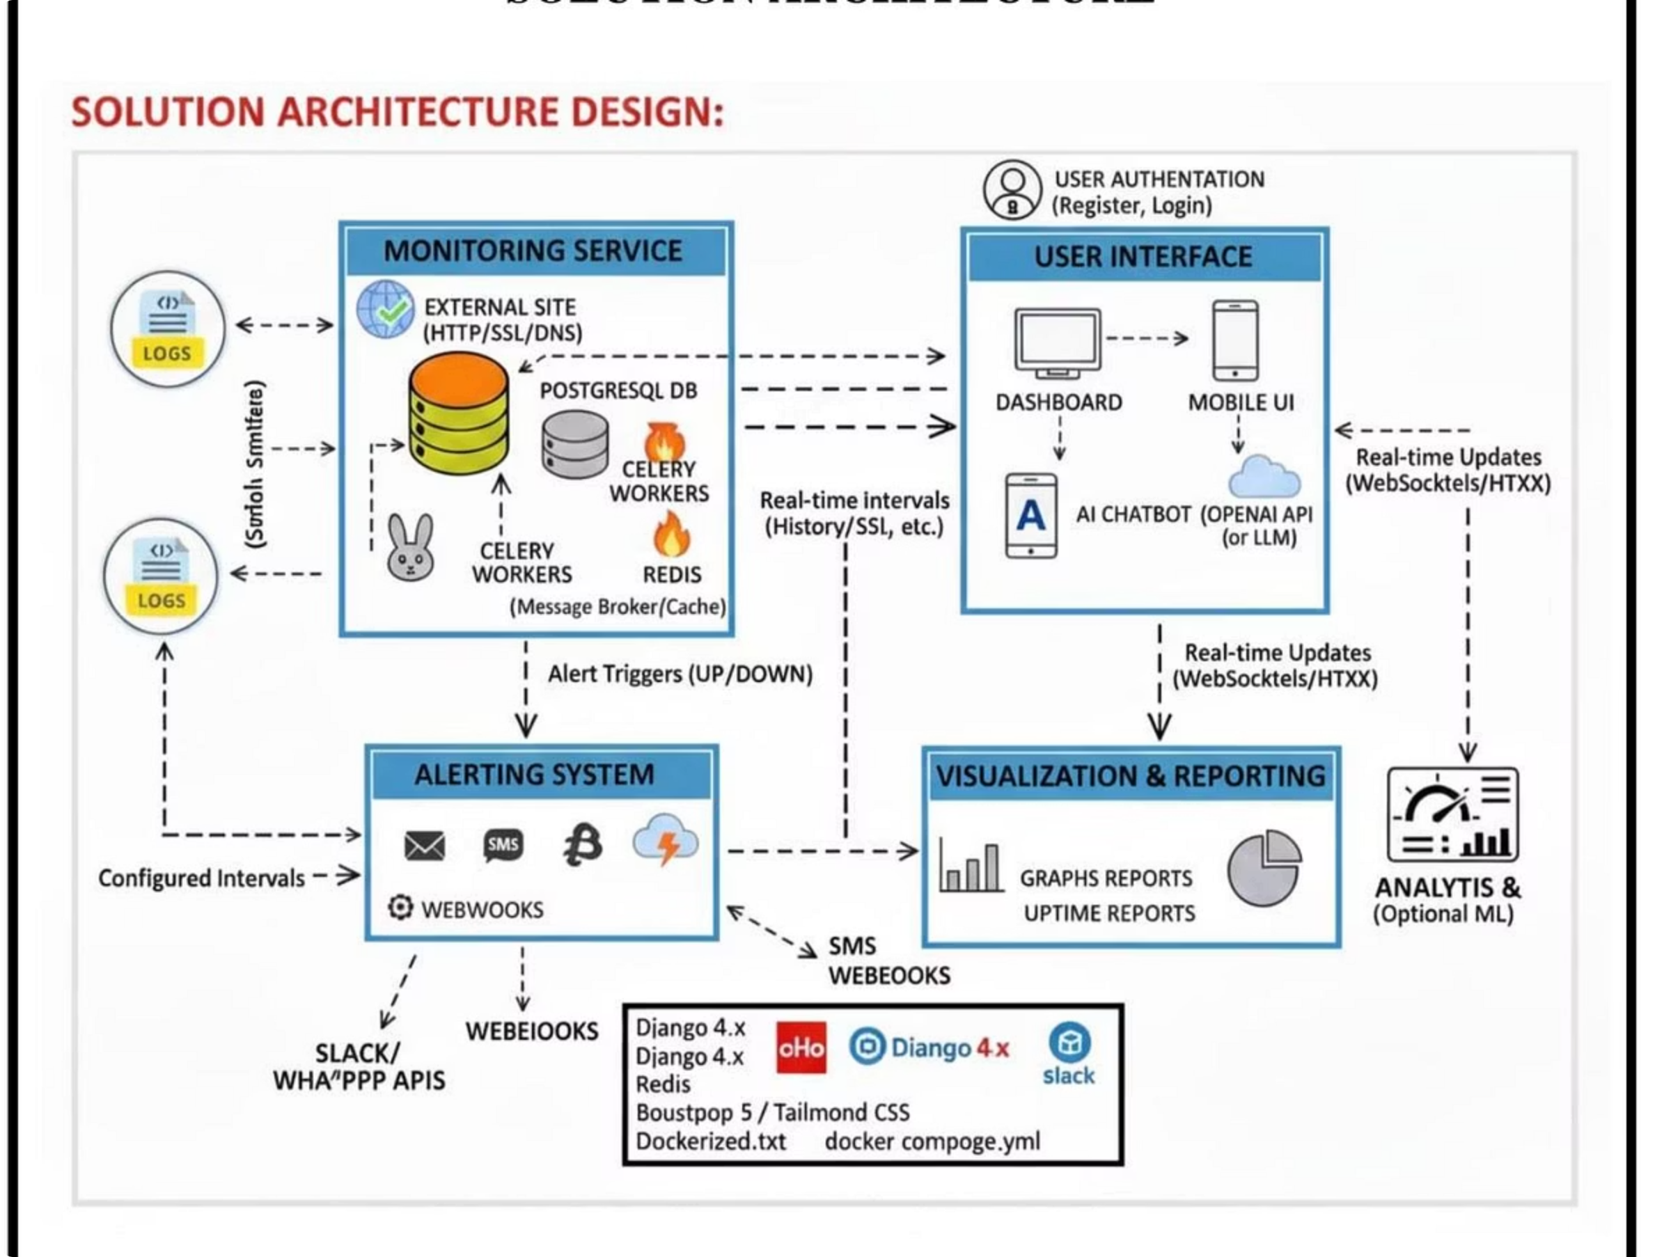
WHAT GOT DONE
Key Results
Live Web Health Monitor (HTTP, SMTP, TLS)
Multi-channel alerts: Email/SMS/Webhook
Real-time dashboard + Celery bg checks
RFC-based validation (7231, 5321, 5322, 9110)
New Ideas
Unified JSON Alert Payload (proposed I-Draft)
SLOW-state via latency threshold
Cross-channel standardized alerts
Github link : https://github.com/Keerthana-star/SYNOVIA-Website-health-monitor
Demo link : https://screenapp.io/app/v/BUKIAPJY_h
AIORI-2
Hackathon 2025, Grand Finale

Slide 4
WHAT WE LEARNED
Lessons Learned
RFCs help consistent behavior
SLOW-state needs clearer definition
Multi-channel alerts need alignment
Inter-op depends on strict formatting
Issues in Current RFCs
No guidance for multi-channel alerting
No definition for SLOW thresholds
SMTP/MIME not optimized for automation
HTTP timeout behaviour varies by client
Feedback to WG
Need operational guidelines for alerts
Define SLOW/latency best practices
Improve inter-op clarity between Email/SMS/API
Feedback to WG
Need operational guidelines for alerts
Define SLOW/latency best practices
Improve inter-op clarity between Email/SMS/API
New Work for WG
Propose unified alerting terminology
Create ops guidance for multi-channel alert systems
Publish inter-op findings + test results
AIORI-2
Hackathon 2025, Grand Finale

Slide 5
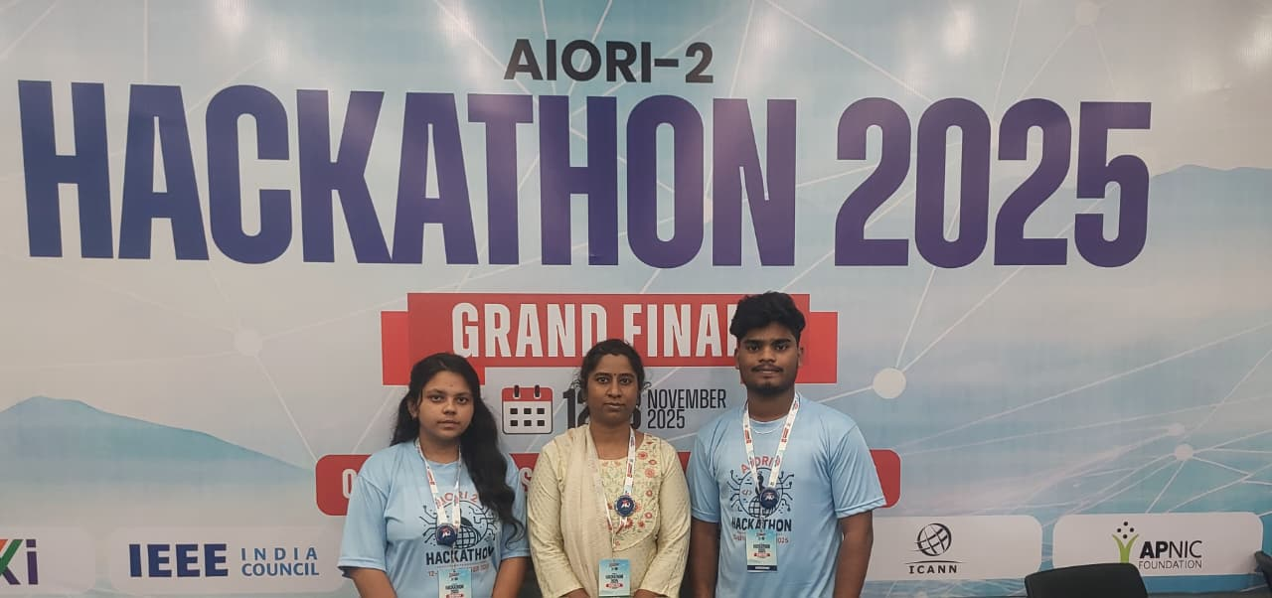
WRAP UP
Team Members:
Kamal S –
https://www.linkedin.com/in/kamal-s-110289314
Keerthana C –
https://www.linkedin.com/in/contkeerthi18
Suma S (Mentor) –
https://www.linkedin.com/in/suma-s-78b49488
Video links
Project explanation: (better understanding)
https://screenapp.io/app/v/VfjjHPnEcF
AIORI-2
Hackathon 2025, Grand Finale

