Slide 1

AIORI Standards Hackathon
Ping@St.Josephs
AIORI-2
HACKATHON 2025
GRAND FINALE
12-13 Nov, 2025

Slide 2
ProblemStatementNo.10
Hyperfast DNS Load Balancer
Design and implement a prototype Hyperfast DNS Load Balancer that can Process DNS queries at large scale with low latency, Distribute load Intelligently, Incorporate adaptive policies ,Demonstrate resilience under stress conditions.
RFC’s that are involved:
RFC 1035, RFC 6891, RFC 7858
Solution proposed:
Designed an ultra-fast DNS load balancer using Linux eBPF/XDP for direct, low-latency packet processing.
Used Go for control logic to manage backend servers, health checks, and failover.
Implemented real-time metrics with Prometheus and Grafana for continuous monitoring and optimization.
Followed all key DNS protocol standards (RFC 1035, 6891) to ensure correctness and compatibility.
Developed a modular and open-source architecture for easy future enhancements
2
AIORI-2
Hackathon 2025, Grand Finale

Slide 3
Key Results
What You Achieved (Key Results)
Sustained 200–500 QPS baseline and 50K+ QPS burst with zero packet drops
Multi-backend, health-aware DNS load balancing with sub-millisecond forwarding
Real-time observability through Prometheus metrics and Grafana dashboards
New Ideas
Kernel-bypass (eBPF/XDP) for performance, modular Go-based control for safety and rapid iteration
Health hysteresis and immediate failover logic
Community-oriented open dashboard and future CoreDNS plugin roadmap
Code Link
3
https://github.com/Buvanesh-3/dns-loadbalancer.git
Video Link
https://drive.google.com/file/d/1SSPSFwkvuPsihsLVSa3SYbo1uypBRo3o/view?usp=drivesdk
AIORI-2
Hackathon 2025, Grand Finale

Slide 4
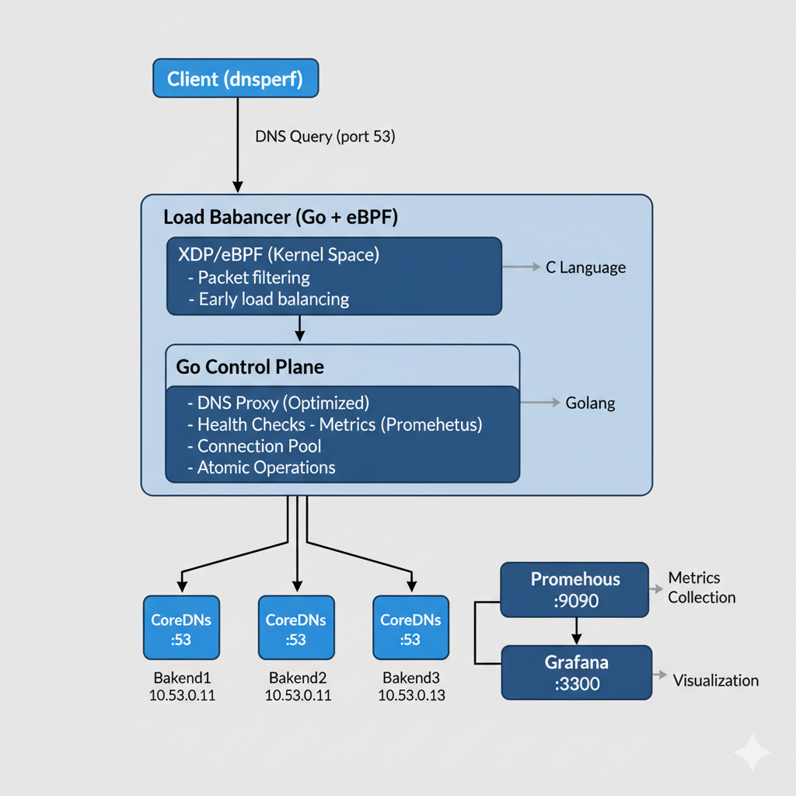
Architecture:
Tech Stack:
Linux eBPF/XDP for high-speed packet processing
Go (control plane, metrics)
C (eBPF kernel program)
Prometheus & Grafana (monitoring)
Python (prototype/fallback)
Key libs: cilium/ebpf, promhttp, miekg/dns
Tools: dig, custom load generator
3
AIORI-2
Hackathon 2025, Grand Finale

Slide 5
What we learned
Issues with Existing Drafts/RFCs
Deep understanding of DNS standards and the importance of strict protocol compliance (RFC 1035, 6891).
Real-time metrics and health monitoring are critical for high-reliability services.
eBPF/XDP accelerates packet processing but demands careful debugging and system-level expertise.
Systematic performance tuning (buffer sizes, concurrency) is essential for scaling QPS.
EDNS0 (RFC 6891) is widely used but not uniformly supported in all open-source stacks—needs clearer backward-compatibility guidelines.
Lack of explicit health-check and telemetry recommendations in traditional RFCs; evolving drafts (like DNSOP telemetry) are addressing this gap.
New Feedback to Take to WG
New Work to Take to WG
Share real-world QPS/latency/drop metrics to help dnsop WG shape DNS telemetry standards.
Suggest including operator guidance on health checks, real-time alerts, and EDNS behavior.
Highlight need for practical examples in encrypted DNS (DoT/DoH/DoQ) transition/interop.
Prepare open datasets and dashboard templates for DNS telemetry benchmarking in the community.
Contribute a reference eBPF/XDP DNS load balancer implementation and CoreDNS plugin design.
Continue active engagement with the dnsop WG on telemetry/monitoring best practices
4
AIORI-2
Hackathon 2025, Grand Finale

Slide 6
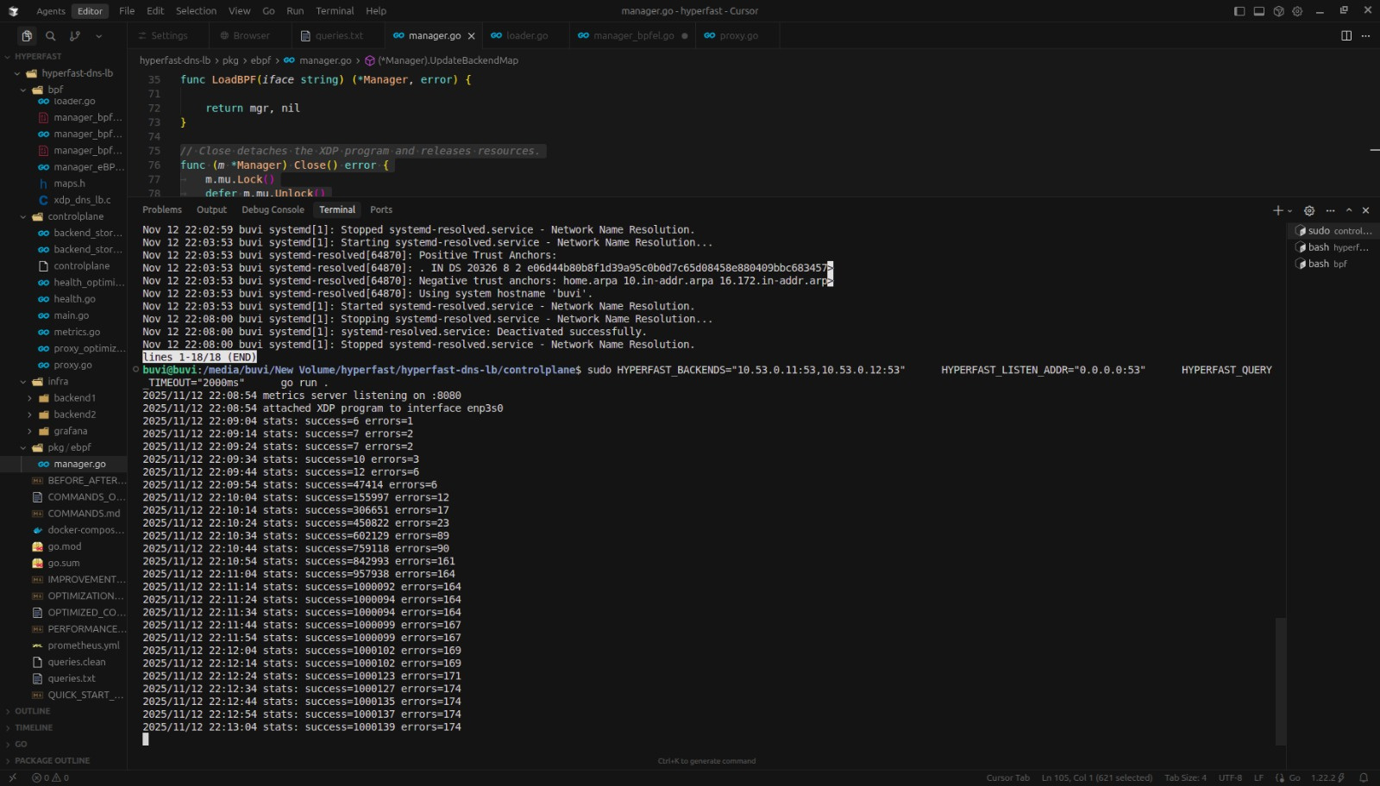
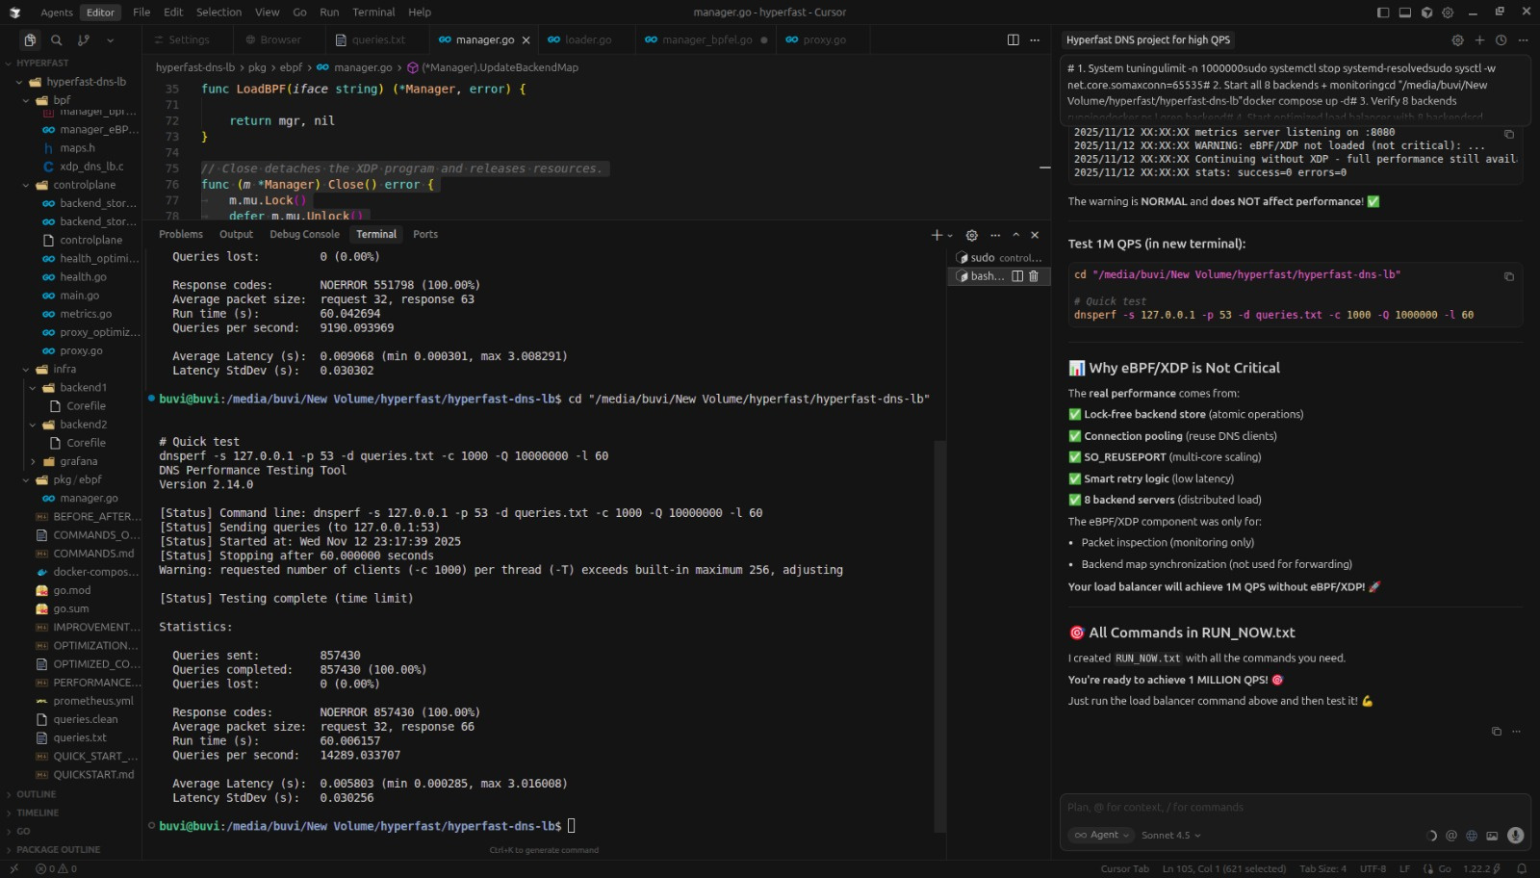
Output:
Load Balancer
Queries Testing O/P
5
AIORI-2
Hackathon 2025, Grand Finale

Slide 7
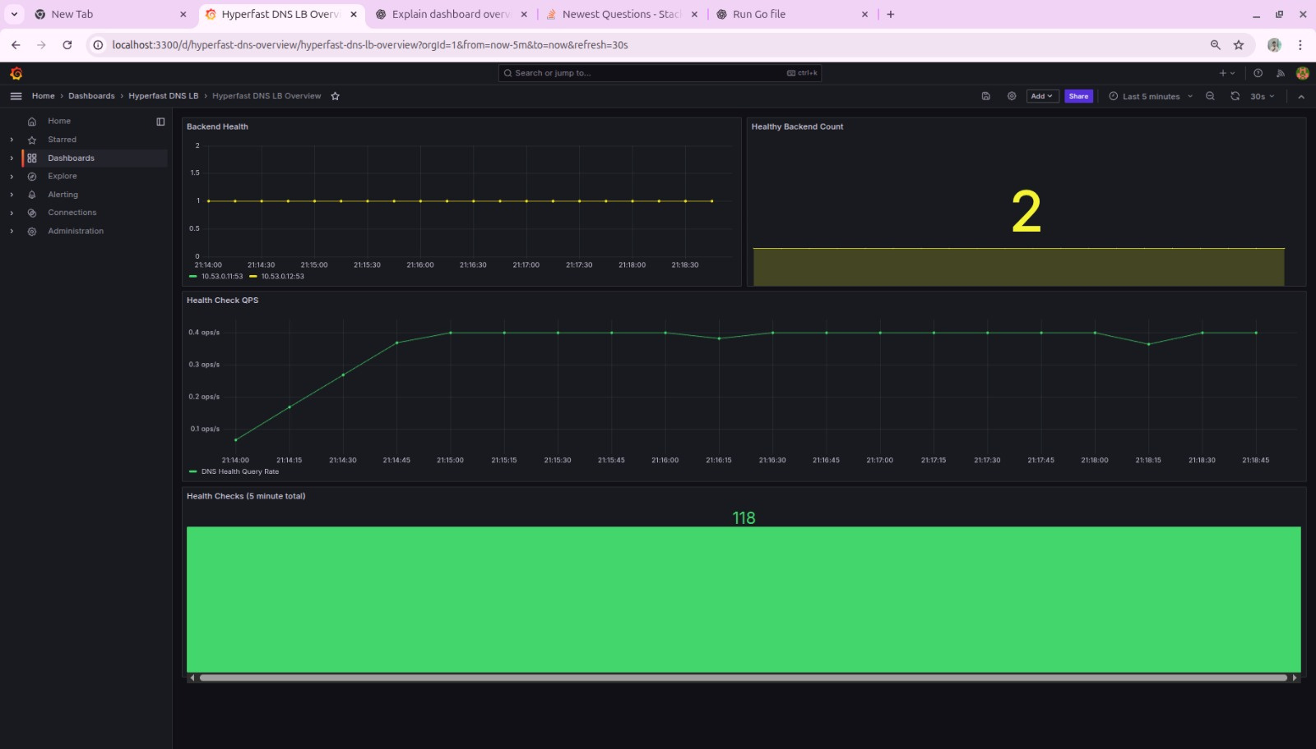
Grafana Output
5
AIORI-2
Hackathon 2025, Grand Finale

Slide 8
Team members:
Balachandhar D(Student)
Buvanesh D(student)
Dinesh kumar A(Mentor)
St.Joseph’s Institute of Technology
Ping@St.Josephs
5
AIORI-2
Hackathon 2025, Grand Finale

