Slide 1

AIORI Standards Hackathon
OrbitOps
AIORI-2
HACKATH
ON 2025
GRAND FINALE
12-13 Nov, 2025

Slide 2
Hackathon Plan
Problem Focus:
Simulate Low Earth Orbit (LEO) satellite constellations for optimal topology, using inter-satellite links (ISLs) to minimize end-to-end latency between ground stations
Relevant Standards:
RFC 9717 – A Routing Architecture for Satellite Networks (core guidance on scalable, dynamic routing for large LEO constellations)
Key Challenges:
How do orbit count, inclination, and satellite density affect latency and coverage?
What is the minimum configuration for low-latency paths?
How should constellation design align with realistic ground user distribution?
Solution Approach:
Develop a simulation platform for generating and benchmarking various constellation topologies.Measure end-to-end latency for different plane/inclination/satellite count settings.Visualize satellite positions, ISLs, and shortest paths in 3D—aligned with ground station locations.Analyze and recommend optimal parameters for reliable, low-latency connectivity
AIORI-2
Hackathon 2025, Grand Finale

Slide 3
What got done
What you achieved?
Trial | Case | Source/Type | GS1 (lat, lon) | GS2 (lat, lon) | Planes | Sats/Plane | Inclination (deg) | Total Sats | Latency (ms) | Path Hops
Trial 1 | Real-time OneWeb | Official Network | 63.5888, 154.4931 | -22.9068, -43.1728 | 12 | 54 | 87.9 | 648 | 68.41 | 10
Trial 1 | Walker Simulation | Model | 63.5888, 154.4931 | -22.9068, -43.1728 | 24 | 27 | 79 | 648 | 62.46 | 11
Trial 2 | Real-time OneWeb | Official Network | 67.5888, 14.4931 | -25.9068, -4.1729 | 12 | 54 | 87.9 | 648 | 51.20 | 11
Trial 2 | Walker Simulation | Model | 67.5888, 14.4931 | -25.9068, -4.1729 | 24 | 27 | 80 | 648 | 42.46 | 7
Trial 3 | Real-time OneWeb | Official Network | 87.258963, -9.369852 | 58.2698, 5.26985 | 12 | 54 | 87.9 | 648 | 23.14 | 4
Trial 3 | Walker Simulation | Model | 87.258963, -9.369852 | 58.2698, 5.26985 | 12 | 54 | 76 | 648 | 10.69 | 4
AIORI-2
Hackathon 2025, Grand Finale

Slide 4
New ideas:
Sweeping inclination/plane parameter space with performance visualization provides actionable insights for constellation planners and network architects.
New design/architecture:
Dynamic simulation with live ground station input, automated nearest-satellite selection, realistic ISL constraints, and integration with geospatial visualization using Plotly.
GitHub Links :
https://github.com/thanushree0122/LEO-Satellite-Network-Topology-Latency-Optimizations
https://github.com/thanushree0122/LEO-Satellite-Network-Topology-Latency-Optimizations/blob/main/Directory/onewebrealtimedata.py
https://github.com/thanushree0122/LEO-Satellite-Network-Topology-Latency-Optimizations/blob/main/Directory/walker.py
https://github.com/thanushree0122/LEO-Satellite-Network-Topology-Latency-Optimizations/blob/main/Directory/benchmark.py

Slide 5
What we learned
  From this hackathon, we learned that topology flexibility—including the number of planes, inclination, and satellite density plays a major role in determining LEO network performance, as small adjustments can significantly reduce latency and improve connectivity.
  Issues with existing drafts/RFCs
  Many existing drafts assume static or simplified satellite topologies, which does not reflect real LEO dynamics.
  Real LEO networks require adaptive, performance-driven simulation models to accurately evaluate routing behavior.
  RFC 9717 lacks detailed guidance on key practical aspects such as:
  ISL reliability and link stability
  Variations in ISL availability
  Ground-satellite handover behavior
  There is a need for more concrete simulation methods, benchmarking frameworks, and clear performance criteria.
AIORI-2
Hackathon 2025, Grand Finale

Slide 6
New Implementation guidance
Adjusting constellation parameters such as inclination and the number of orbital planes provides clearer insights into how topology choices influence latency and overall network performance
New feedback to WG
Evaluating how changes in constellation parameters (such as inclination and plane count) affect latency provides valuable insights that can support more effective LEO network design.
Incorporating parameter-based analysis into future discussions can help improve understanding of real-world performance behavior in dynamic satellite networks.
New Work to Take to the WG
It is recommended that the Working Group consider incorporating simulation-based analyses for evaluating LEO network behavior in future discussions.
Introducing structured parameter variation methods—such as adjustments to inclination and orbital plane count—may provide clearer insights into the performance impact of different constellation configurations.

Slide 7
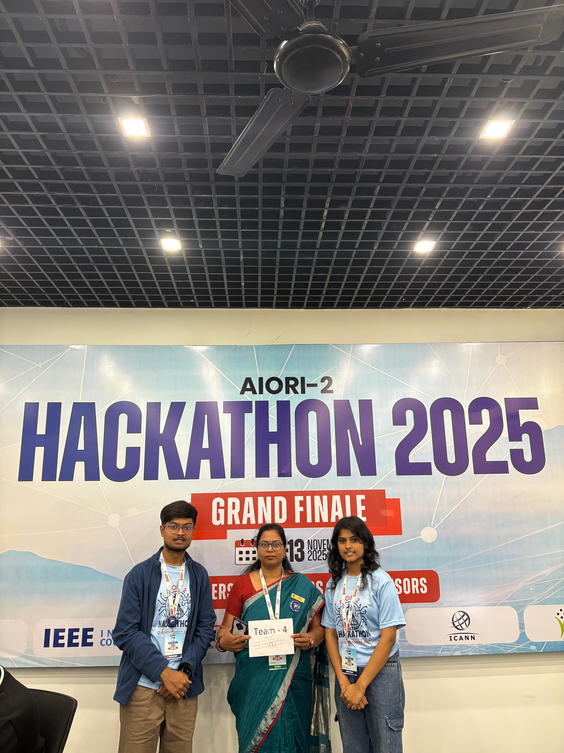
Wrap Up
Team:
OrbitOps
College:
KS School Of Engineering Management
Team members:
Dr. Renuka.V .Tali (Mentor)
Mahesh N
Thanushree N
AIORI-2
Hackathon 2025, Grand Finale

