Slide 1

AIORI Standards Hackathon
GeoSthira
AIORI-2
HACKATHON 2025
GRAND FINALE
12-13 Nov, 2025

Slide 2
Hackathon Plan:-
PS 15: “Supervised Learning for City-Level IP Geolocation”
RFC/Drafts involved: RFC 8805 – Self-Published IP Geolocation Data
RFC 792 / 4443 – ICMP & ICMPv6 for Active Probing
RFC 9081–9083 – RDAP (Registry/ASN/Prefix Data)
Problems to be solved:
Outdated database-based geolocation methods.
IP reassignments and route dynamics causing inaccuracy.
No adaptive, city-level model for Indian networks with confidence Scores.
Solution :
Supervised ML model (Random Forest) trained on IP→city data.
Use of more features like ISP level Patterns ,rDNS, Network performance metrics for improving accuracy.
AIORI-2
Hackathon 2025, Grand Finale

Slide 3
What got done:-
  Idea and Key result: Built pipeline: feature extraction, IQR-based cleaning, label encoding, and trained, tested and validated Random Forest classifier
  Code: https://github.com/geosthira-prog/AIORI-2-HACKATHON-PROJECTS/tree/7e186834d4e32cd0d059739032914b8b41d24830/Frontend_FastAPI
  Novelty: Synthetic regional zones for balanced model training , ongoing DB11- based model for broader IP range.
  Code: https://github.com/geosthira-prog/AIORI-2-HACKATHON-PROJECTS
  Demo video of GEOSTHIRA IP GEOLOCATOR - demo_IPGEOLOCATOR.mp4 - Google Drive
AIORI-2
Hackathon 2025, Grand Finale

Slide 4
What we learned :-
.
  Take away: ML model provides increased accuracy, reliability adaptability for city-level IP geolocation.
  Issues with existing RFC’s/ Drafts :
RFC 8805 and related drafts lack dynamic, ML-based adaptability for real-time IP changes.
No standard method for confidence estimation or handling uncertain IPs like VPN/anycast.
  New Implementation Guidance: Incorporate confidence radius and low-confidence flags in ML-based geolocation systems.
  New feedback to take to WG? : Suggest ML-extensions to RFC 8805 for self-learning IP→city frameworks.
Propose standard guidelines for confidence estimation and error reporting.
  New work to take to WG?:
Extend the DB11-based model for full Indian IP coverage.
Explore nearest-city prediction and multi-feature fusion for more accurate results.
AIORI-2
Hackathon 2025, Grand Finale

Slide 5
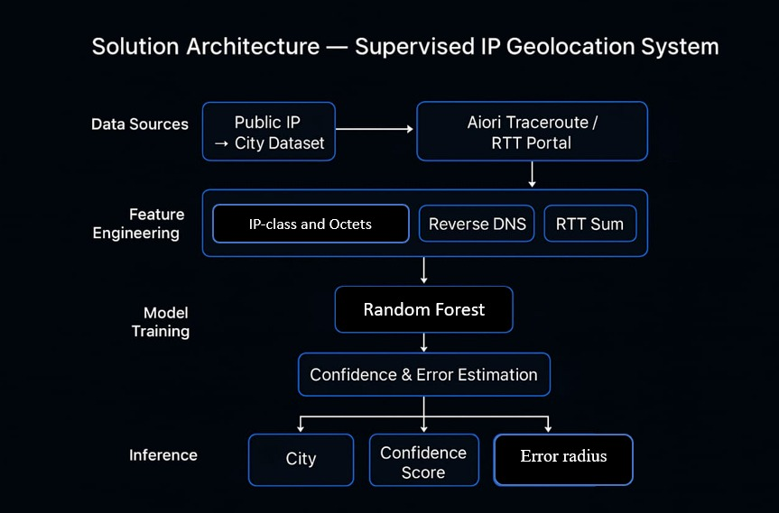
Architecture:

Slide 6
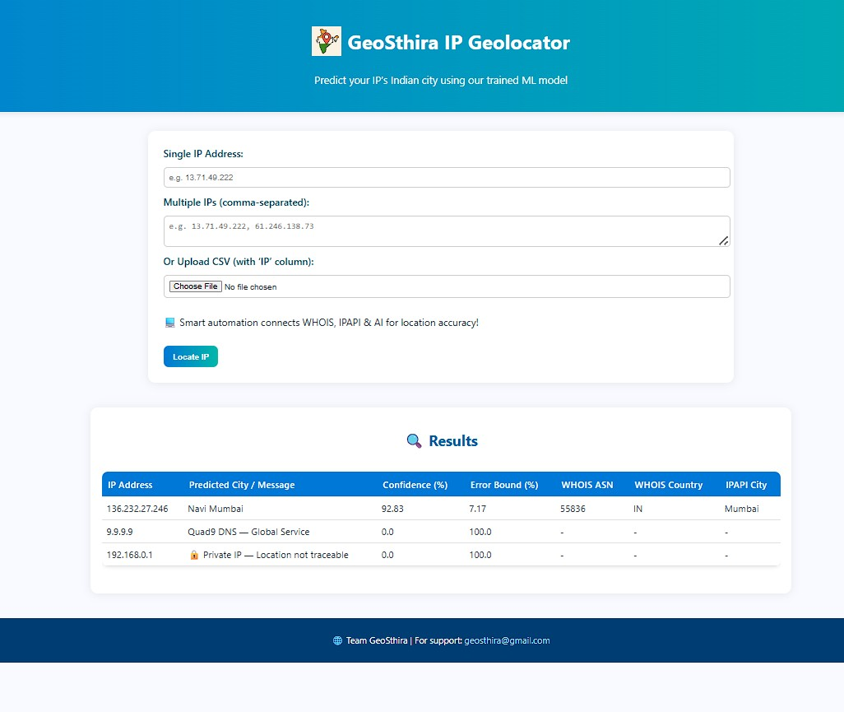
Frontend:

Slide 7
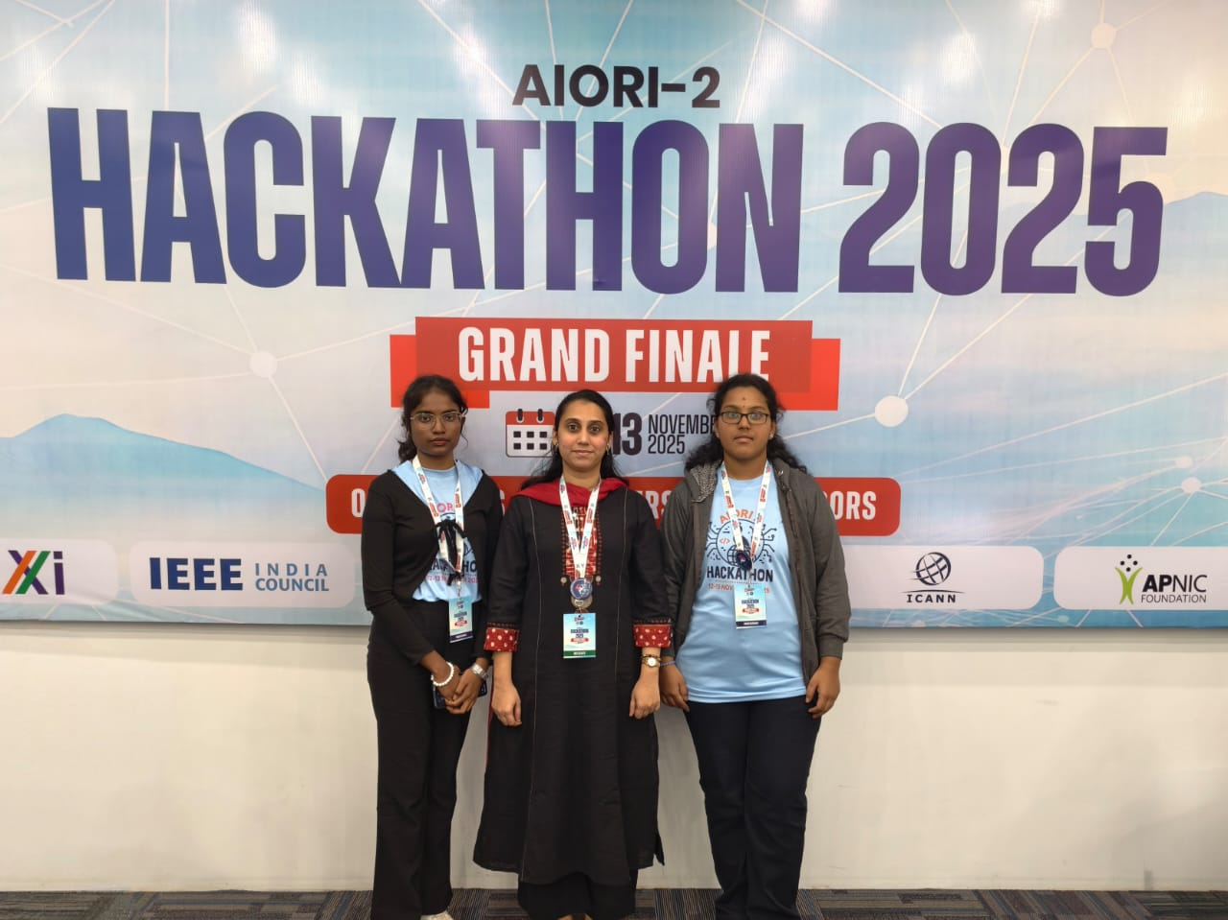
Wrap Up
Team members:
Team – Geosthira
College - Vemana Institute Of Technology, Bangalore
Contributors:
Kavyashree K – B.E, ECE
Margaret Sheela C – B.E. ECE
Mentor1: Sneha Zolgikar, Assistant Professor, Vemana Institute of Technolgy
Mentor2: Debayan Mukherjee, IIFON
AIORI-2
Hackathon 2025, Grand Finale

