Slide 1

AIORI Standards Hackathon
DNinjaS
AIORI-2
HACKATHON 2025 GRAND FINALE
12-13 Nov, 2025

Slide 2
Hackathon Plan
Problem Statement 12: Website Health Monitor with Multi Channel Alerts
RFCs involved: HTTP Semantics 9110/9112, JSON RFC 8259.
Problems Involved:
Websites can suddenly go down due to server or network failures.
There’s no real-time way to see when a site is slow or offline.
Users don’t get quick recovery or downtime alerts.
Planned Solution:
Use Celery to automatically check website status every few seconds.
Show live uptime and response graphs on a dashboard using AJAX and Chart.js.
Send instant in-app (and later email/SMS) notifications for downtime and recovery.
AIORI-2
Hackathon 2025, Grand Finale

Slide 3
What got done?
What was achieved?
Built a Django based website monitoring system that pings target URLs for set intervals of 30 sec
Enabled real time monitoring of URLs, representing results on the dashboard in the form of live graphs through chart.js and AJAX polling.
Implemented In-app notifications so that users get notified about the downtime of target URL
Design/Architecture:
We built the system in a modular way — the backend (Celery) handles all background checks, while the frontend (AJAX and Chart.js) shows live updates and graphs smoothly.
Our monitoring runs continuously in the background using Celery Beat, allowing multiple websites to be checked at the same time without slowing down the system.
AIORI-2
Hackathon 2025, Grand Finale

Slide 4
What got done?
Future Ideas:
To introduce multi-channel alerts via SMS, Emails as per user preferences.
Introduce AI-based anomaly detection to further possible downtime.
Plan to add new dashboard features- exporting detailed reports, MTTR data
https://github.com/Starc6254/DNinjaS-Website-Health-Monitoring--AIORI-2-
AIORI-2
Hackathon 2025, Grand Finale

Slide 5
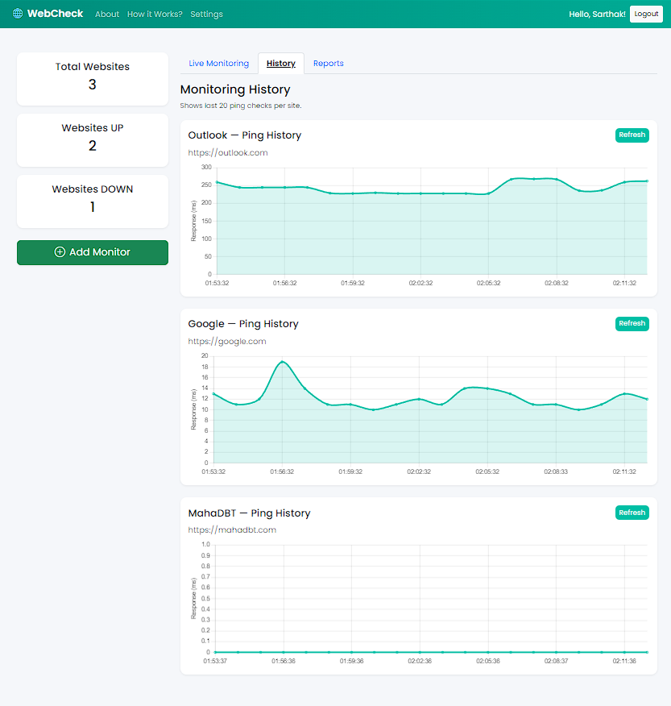
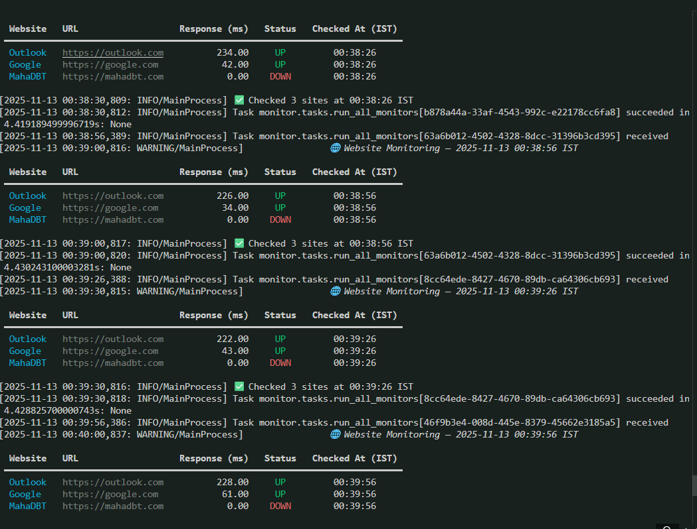
What got done?
Results:
AIORI-2
Hackathon 2025, Grand Finale

Slide 6
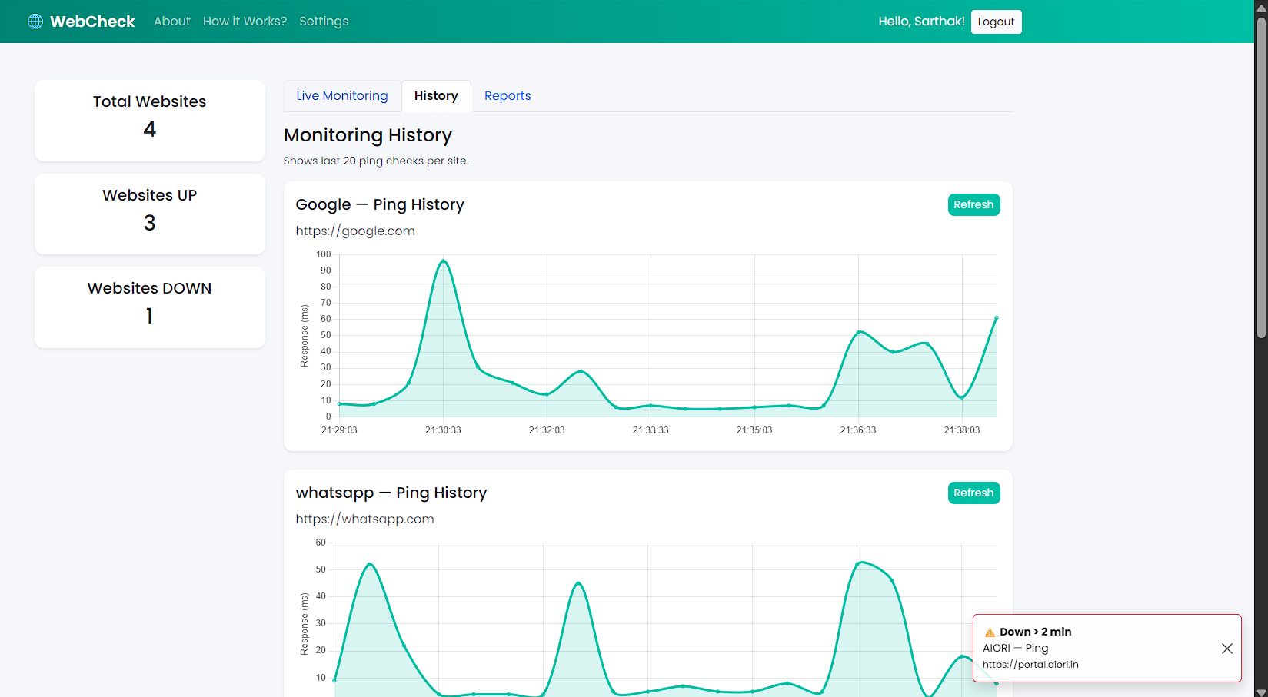
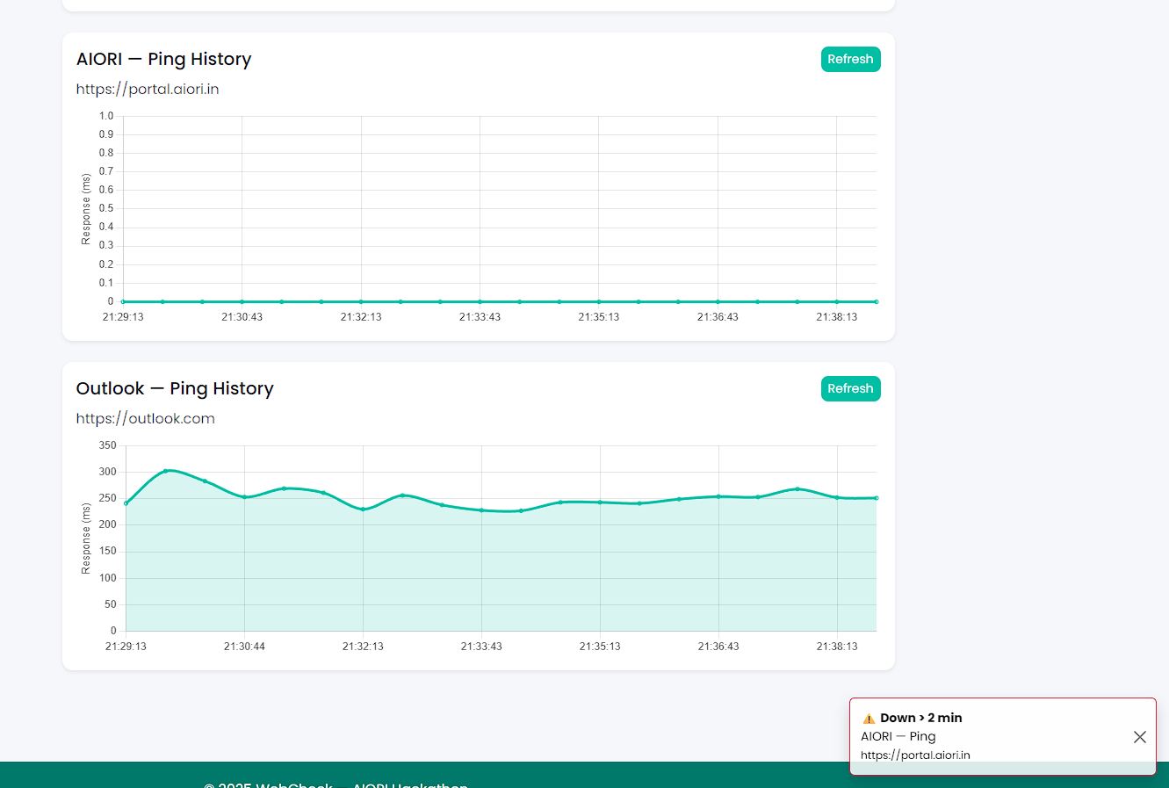
What got done?
Results:
AIORI-2
Hackathon 2025, Grand Finale

Slide 7
What we learned
Lessons Learned:
Building a real-time monitoring system helped us realize importance of background scheduling.
Collaboration and constant testing helped us analyze and resolve key errors and issues with the program.
Issues like wrong timezones, missing migrations, or Celery not running taught us to double-check every component before testing full workflows.
We learned to consider things like slow networks, partial failures, and temporary timeouts, not just complete website downtime.
AIORI-2
Hackathon 2025, Grand Finale

Slide 8
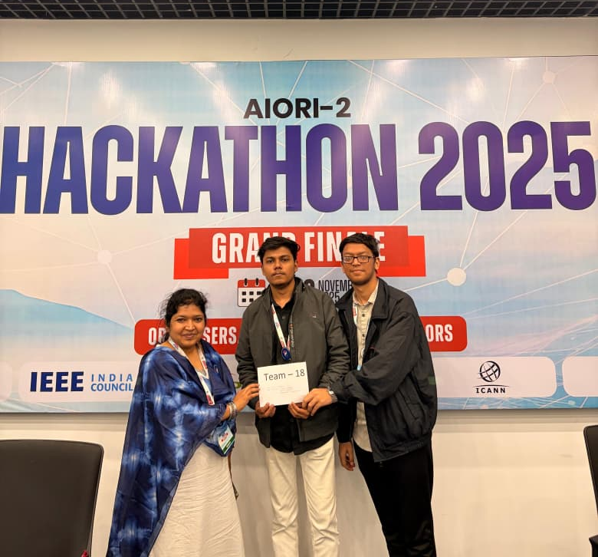
Wrap Up
Team members:
Sarthak Dhamale
Ayush Nakhale
Prof. Bhagyashri Thorat
Github Repository: https://github.com/Starc6254/DNinjaS-Website-Health-Monitoring--AIORI-2-
Profiles(LinkedIn):
www.linkedin.com/in/bhagyashri-thorat-44725115
www.linkedin.com/in/sarthak-dhamale-048457358
www.linkedin.com/in/ayushh133a278
AIORI-2
Hackathon 2025, Grand Finale

