Slide 1

AIORI Standards Hackathon
DDos Duo
AIORI-2
HACKATHON 2025 GRAND FINALE
12-13 Nov, 2025

Slide 2
Hyperfast DNS Load Balancer
Problem Statement 10
AIORI-2
Hackathon 2025, Grand Finale

Slide 3
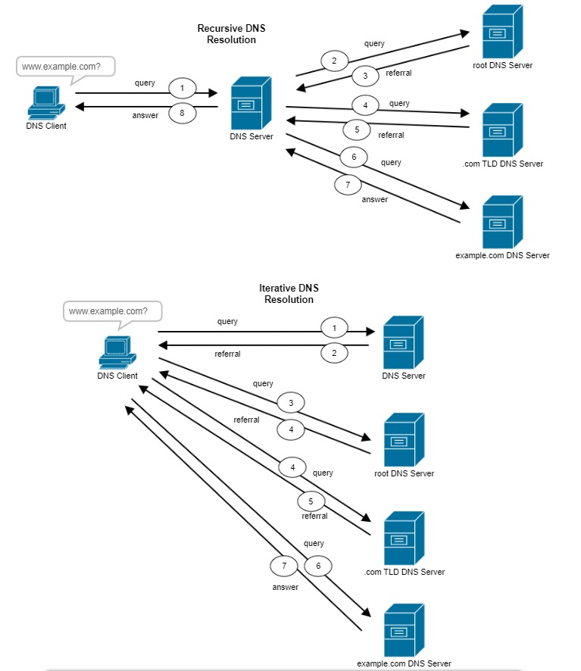
When is it called “Hyperfast” ?
What is DNS ?
DNS is a hierarchical and distributed naming system that translates domain names into IP addresses. When you type a domain name like www.geeksforgeeks.org into your browser, DNS ensures that the request reaches the correct server by resolving the domain to its corresponding IP address.
What is Load Balancing?
Domain Name System(DNS) load balancing is a technique used to distribute network traffic throughout multiple servers or sources to improve overall performance, availability, and redundancy.
Extreme/Hyperfast > 100,000 QPS
Global tech giants (e.g., Google processes ~40,000 searches per second globally)
AIORI-2
Hackathon 2025, Grand Finale

Slide 4
Objectives & Deliverables
Build a high-performance DNS load balancer using kernel-bypass frameworks (XDP + eBPF).
Implement adaptive load balancing algorithms — Round Robin, Weighted RR, Power of Two Choices, and Latency-based.
Integrate health checks.
Deploy Prometheus + Grafana telemetry for real-time QPS and latency visualization.
Achieve ~1.5 Lakh QPS in XDP Generic mode and demonstrate RFC-compliant DNS behavior.
Provide architecture, performance benchmarks, and open-source codebase as the complete deliverable.
Lay the groundwork for scaling to 1 M+ QPS using XDP Native mode with zero-copy I/O and SIMD optimization.
AIORI-2
Hackathon 2025, Grand Finale

Slide 5
Adaptive Load Balancing
Algorithms Implemented
Round Robin (RR): Sequential backend selection.
Weighted Round Robin (WRR): Based on backend capacity.
Power of Two Choices (P2C): Chooses less-loaded backend among two randoms.
Latency-based: Picks backend with lowest recent RTT.
AIORI-2
Hackathon 2025, Grand Finale

Slide 6
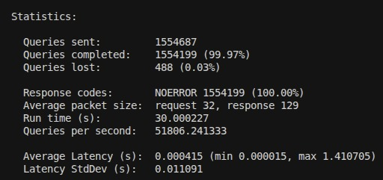
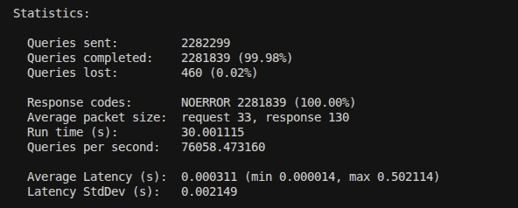
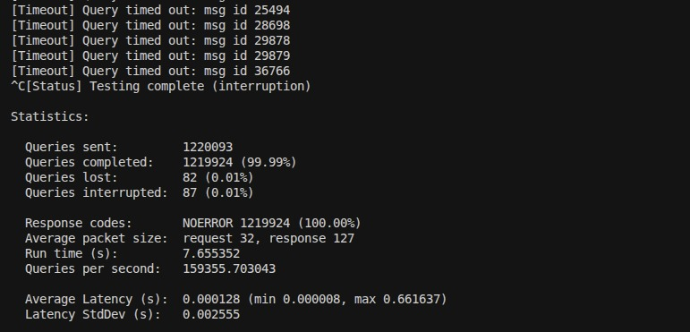
QPS Growth
Round Robin Algorithm
Adaptive Load Balancer
XDP Generic Framework
AIORI-2
Hackathon 2025, Grand Finale

Slide 7
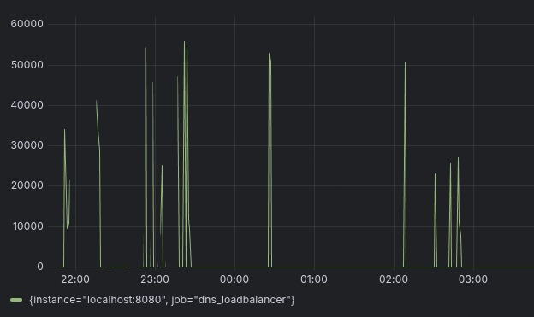
RFC & Results
RFC 1034 & 1035
Defined DNS architecture, message formats, and resolution mechanisms.
Formed the base of our DNS packet processing and validation layer.
Ensured RFC-compliant parsing, caching, and authoritative response handling.
Metric | Result
Throughput | ~1.5 Lakh QPS
Average Latency | ~0.9 ms
Health Check Interval | 2000 ms

Slide 8
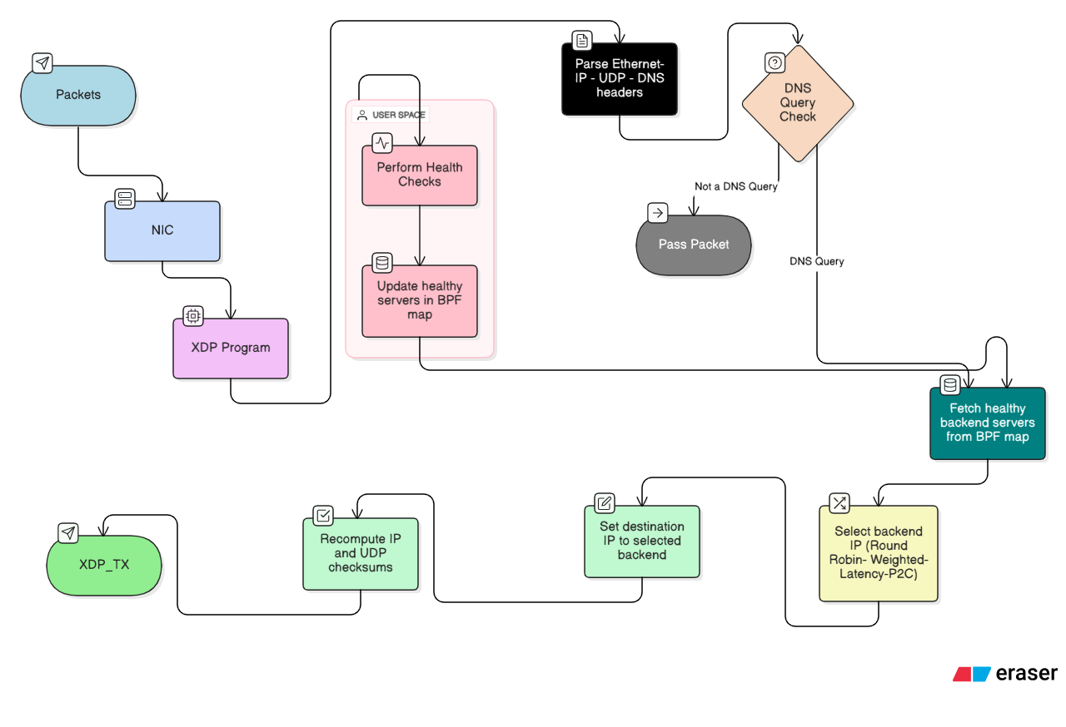
Workflow
AIORI-2
Hackathon 2025, Grand Finale
!! Generic XDP cannot reach 1M QPS due to lack of zero-copy and hardware driver support.

Slide 9
XDP Framework (Generic Mode)
Implemented load balancer prototype using XDP Generic mode.
Used bpftool for managing and attaching eBPF programs to interfaces.
Deployed 3 BIND servers as authoritative backends.
Integrated Prometheus exporters for real-time QPS and latency.
Outcome:
Achieved ~150K QPS with adaptive balancing but hit kernel bottlenecks.
Reason:
XDP Generic runs in software path, not at NIC driver level.
AIORI-2
Hackathon 2025, Grand Finale

Slide 10
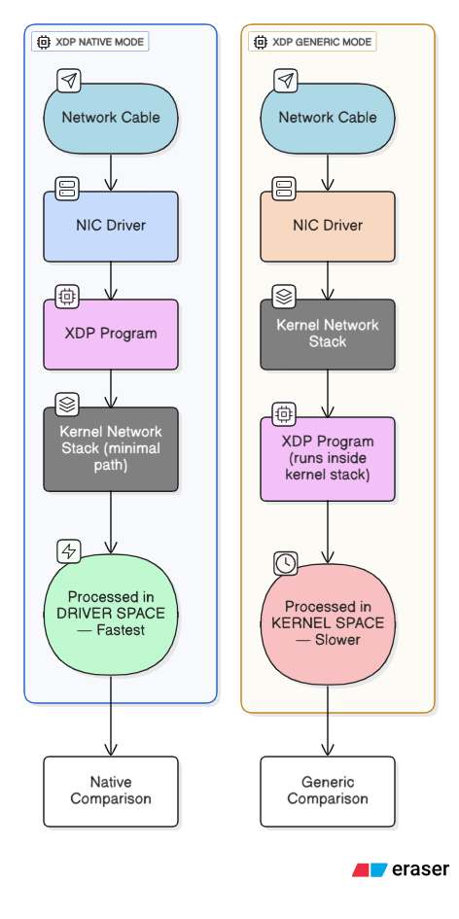
XDP Architecture
AIORI-2
Hackathon 2025, Grand Finale

Slide 11
XDP Framework (Native Mode)
Why Native Mode?
Runs inside NIC driver RX path → true kernel bypass.
Enables zero-copy packet transfer via AF_XDP.
Supports SIMD acceleration in user-space parsing.
Expected Outcome
Achieve 1M+ QPS with sub-millisecond latency using XDP Native mode.
Why Important ?
RFCs don’t currently address kernel-bypass DNS architectures.
Creates an implementation gap for high-performance, RFC-compliant DNS at scale.
Future work can contribute guidance for integrating eBPF/XDP into DNS RFCs
AIORI-2
Hackathon 2025, Grand Finale

Slide 12
RFC 1794 & Standardization Gap
Introduced load balancing using multiple A records.
Obsolete for modern DNS - static rotation, no feedback loop.
Doesn’t address adaptive algorithms, latency awareness, or telemetry feedback
Current Landscape
Commercial systems (e.g., PowerDNS, DNSdist) use proprietary adaptive logic.
No standardized RFC defines adaptive DNS load balancing behaviour.
Identified Gap
Need for a new IETF draft or RFC on “Adaptive DNS Load Balancing via Kernel Bypass and Real-Time Telemetry.”
AIORI-2
Hackathon 2025, Grand Finale

Slide 13
Future Implementations
Deploy on XDP Native Hardware Utilize NICs with full XDP driver support to achieve 1 M+ QPS and true zero-copy performance.
Implement Encrypted DNS (DoH / DoT / DoQ) Extend the balancer to handle secure DNS protocols while maintaining low latency.
Introduce AI-Based Adaptive Routing Use real-time telemetry and ML models to auto-optimize algorithm selection and predict congestion.
Add Anycast and Geo-Aware Load Distribution Integrate geographic routing and Anycast IPs for global, latency-aware DNS resolution.
AIORI-2
Hackathon 2025, Grand Finale

Slide 14
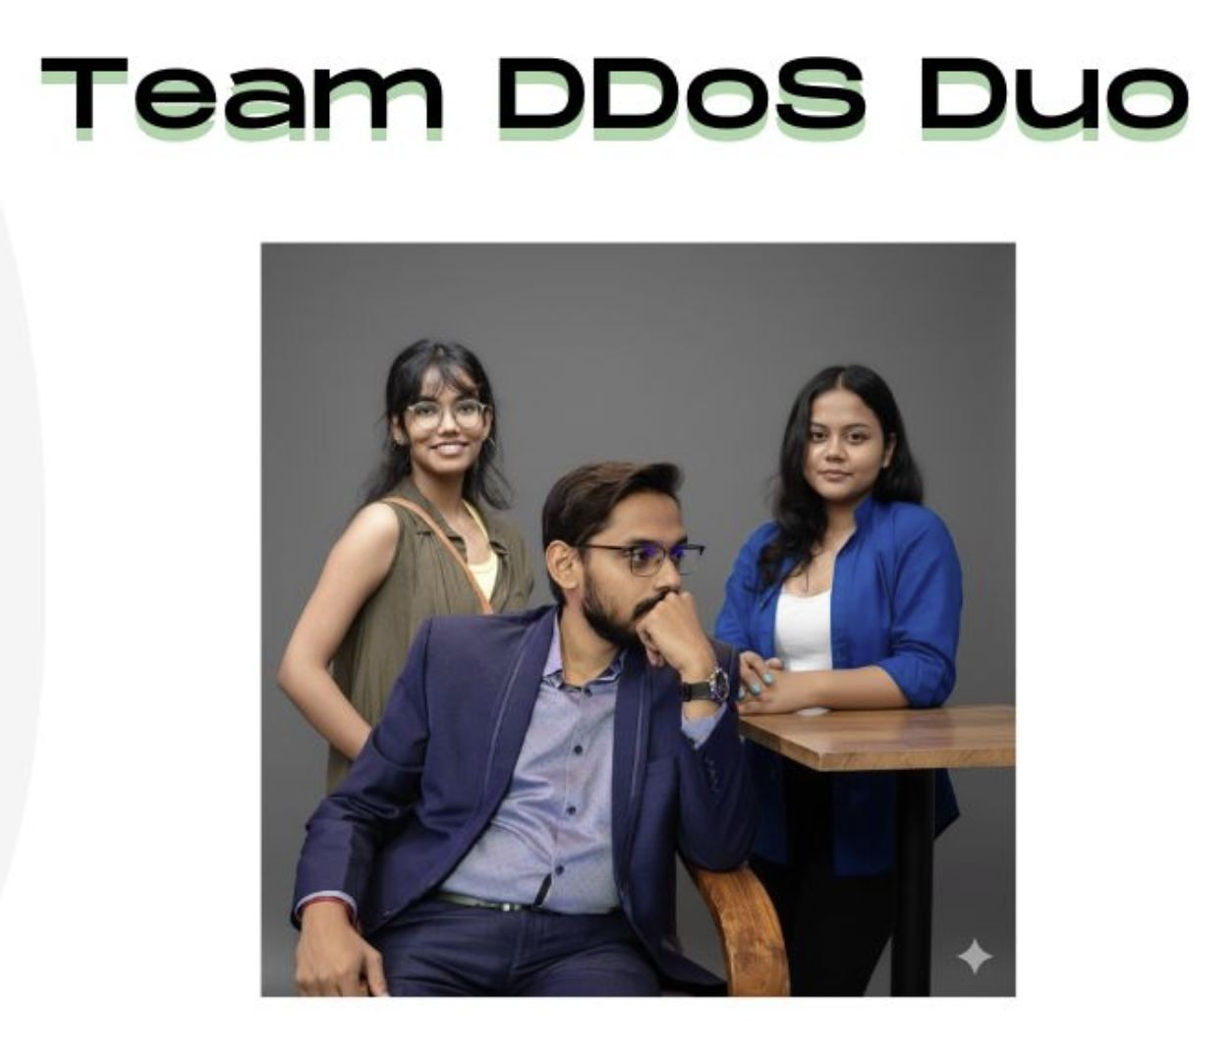
Team
Mentor:
Jhalak Dutta
https://www.linkedin.com/in/jhalak-dutta-hitkcse
Members:
1. Gargi Lodh
https://www.linkedin.com/in/glodh18
2. Devayanee Gupta
https://www.linkedin.com/in/dg2805/
Heritage Institute of Technology, Kolkata
GitHub Link:
https://github.com/glodh21/DDos_Duo
AIORI-2
Hackathon 2025, Grand Finale

