Slide 1

AIORI Standards Hackathon
ChristUniversityTeam3
AIORI-2
HACKATHON 2025
GRAND FINALE
12-13 Nov, 2025

Slide 2
Hackathon Plan
Problem Statement: Octant-Based IPGeolocation via AIORI Active Measurements
  What drafts/RFC’s were involved?
    RFC 8805 – JSON-based IPv4/IPv6 geolocation representation
    AIORI IMN specification – Active measurement node behavior
  Specific problems to solve:
    Convert real-time RTTs → distance constraints
    Combine multiple probes to estimate actual IP location
    Build modular algorithms: Octant like algorithms, and Multilateration and MBC for comparison
    Visualize the constraints and results on a live map
How you planned to solve it?
  Create a Flask-based backend to parse probe RTT logs
  Implemented an Octant-like geometric solver using modularised code
  Provide interface for users to provide their own algorithm based on a template to encourage a cycle of exchange where users can contribute to the project
  Build a UI for probe input, computations & visual maps
AIORI-2
Hackathon 2025, Grand Finale

Slide 3
What got done
An Octant-like IP geolocation solution using python and html.
We created few Octant like algorithms to find IP geolocation using the ping measurements generated for an IP address by firing from probes through the AIORI platform as input for our project.
We created a platform where users can use their own algorithms to solve the IP geolocation problem along with the available algorithms which were developed by us.
We got results pointing to IP geolocation with limited precision for our algorithm.
  GitHub Repository link - https://github.com/tpaldenb/AIORI-Octant-based-geolocation-app.git
AIORI-2
Hackathon 2025, Grand Finale

Slide 4
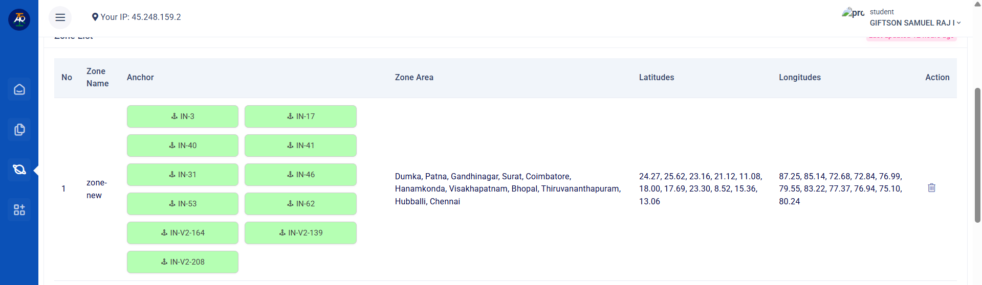
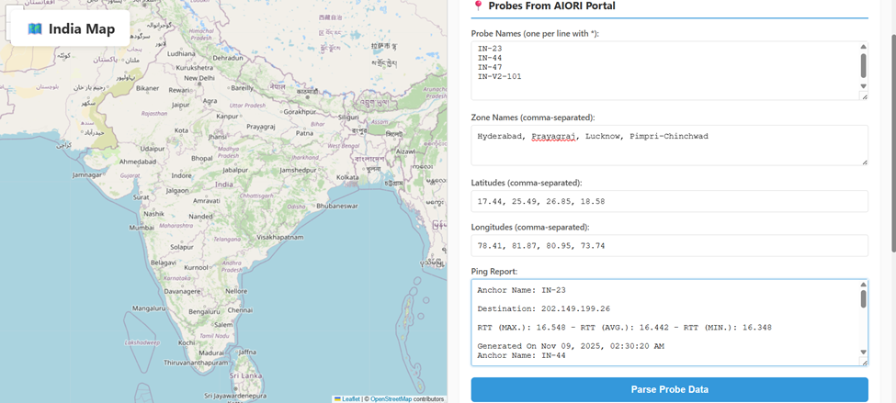
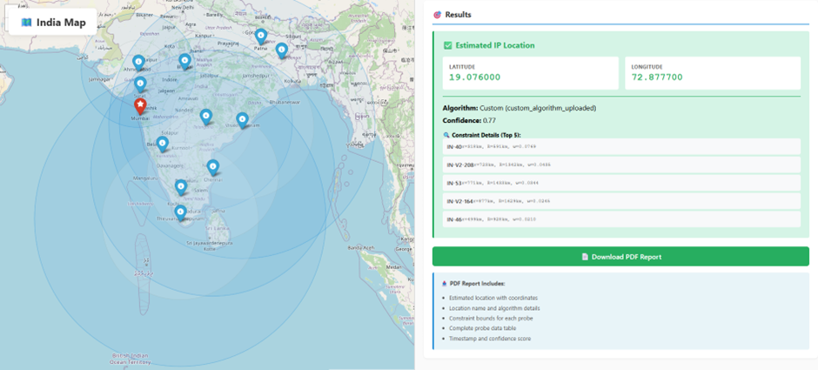
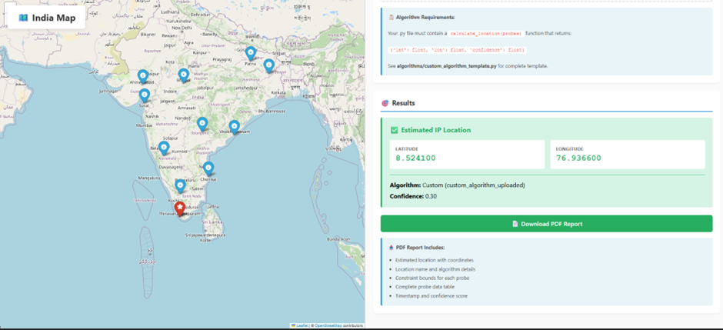
AIORI Probes → Collect RTTs to target IP
UI for probe input, computations & visual maps
Ip address of Mumbai
Ip address of Thiruvananthapuram

Slide 5
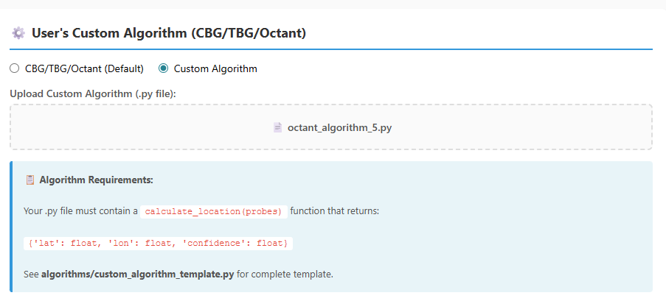
User’s can add their own algorithm here

Slide 6
What we learned
The Octant concept of IP geolocation calculation as proposed in the “Octant: A Comprehensive Framework for the Geolocalization of Internet Hosts” paper by Cornell University.
Studied how ping and RTT values work.
A non machine learning based mathematical approach for IP geolocation prediction.
Other approaches to IP geolocation calculation.
The need for IP geolocation.
AIORI-2
Hackathon 2025, Grand Finale

Slide 7
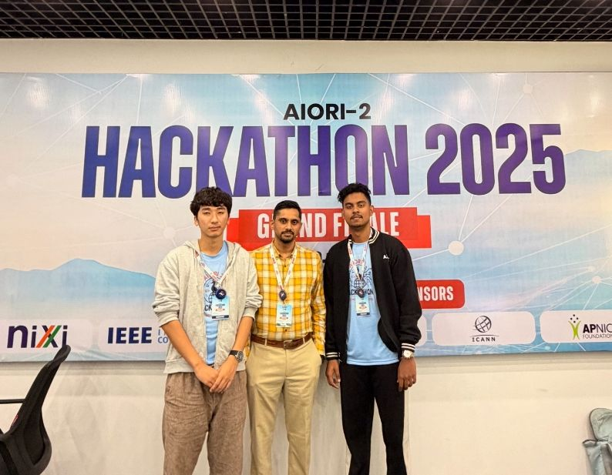
Wrap Up
Team members:
Tenzin Palden Bhutia
https://www.linkedin.com/in/tenzin-palden-bhutia-454046289/
Giftson Samuel Raj I
https://www.linkedin.com/in/giftson-samuel-raj-856bb5249/
Mentor name:
Dr. Manu Ellappila
https://www.linkedin.com/in/dr-manu-elappila/
<Other links, contacts or notes>
AIORI-2
Hackathon 2025, Grand Finale

