Slide 1

AIORI Standards Hackathon Caffeine Coders
AIORI-2
HACKATHON 2025 GRAND FINALE
12-13 Nov, 2025

Slide 2

Hackathon Plan
Problem Statement 06: Anycast flipping and CDN user experience
"From reactive to proactive: Outpacing anycast disruptions with predictive intelligence.”
RFC’s INVOLVED:
RFC / Draft No. Title / Area Lifecycle Stage How This Work Relates
RFC 4786
Operation of Anycast Best Current Practice Services
Validates Section 3.2 - Demonstrates real-world performance degradation during anycast flips and provides empirical data on 2000ms+ disruption costs described theoretically.
Defines requirements for CDN interconnection and interfaces, which the client-side caching solution complements by improving resilience across CDNs.
RFC 7337 (former draft-ietf-cdni- requirements-22)
CDN Interconnection Requirements
Internet standard
2
Specific Problem to solve!?
Current anycast networks react to BGP flips, causing session interruptions and slow responses; our goal is to proactively prevent this via predictive cache pre-positioning.
AIORI-2
Hackathon 2025, Grand Finale

Slide 3
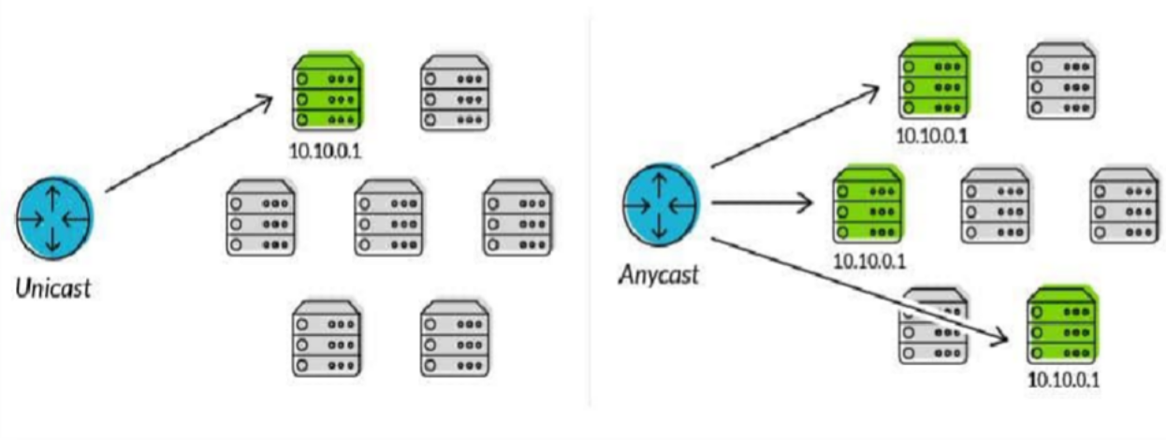
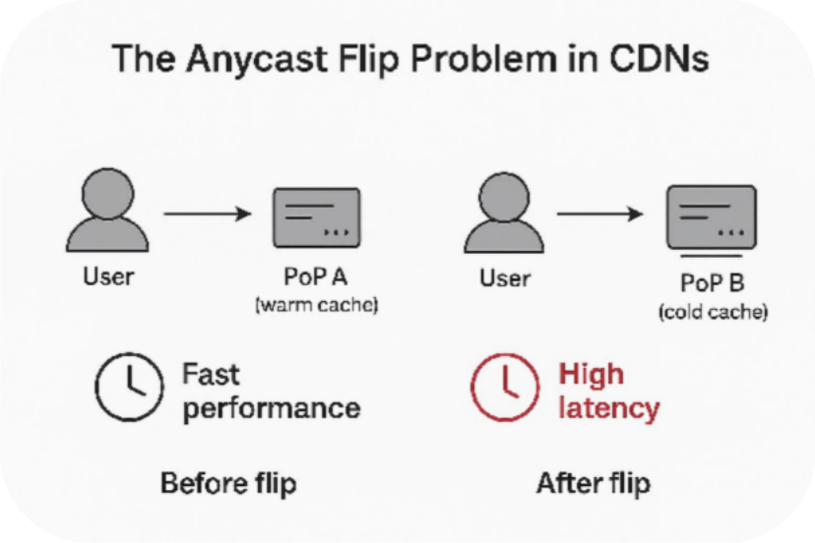
Anycast - What do we understand?
Proactive Traffic Routing
Multiple servers, one IP—traffic goes to the closest for optimal performance.
Whereas Anycast flipping is ?
Anycast flipping reroutes traffic unexpectedly, causing latency spikes and ses³sion interruptions.
AIORI-2
Hackathon 2025, Grand Finale

Slide 4
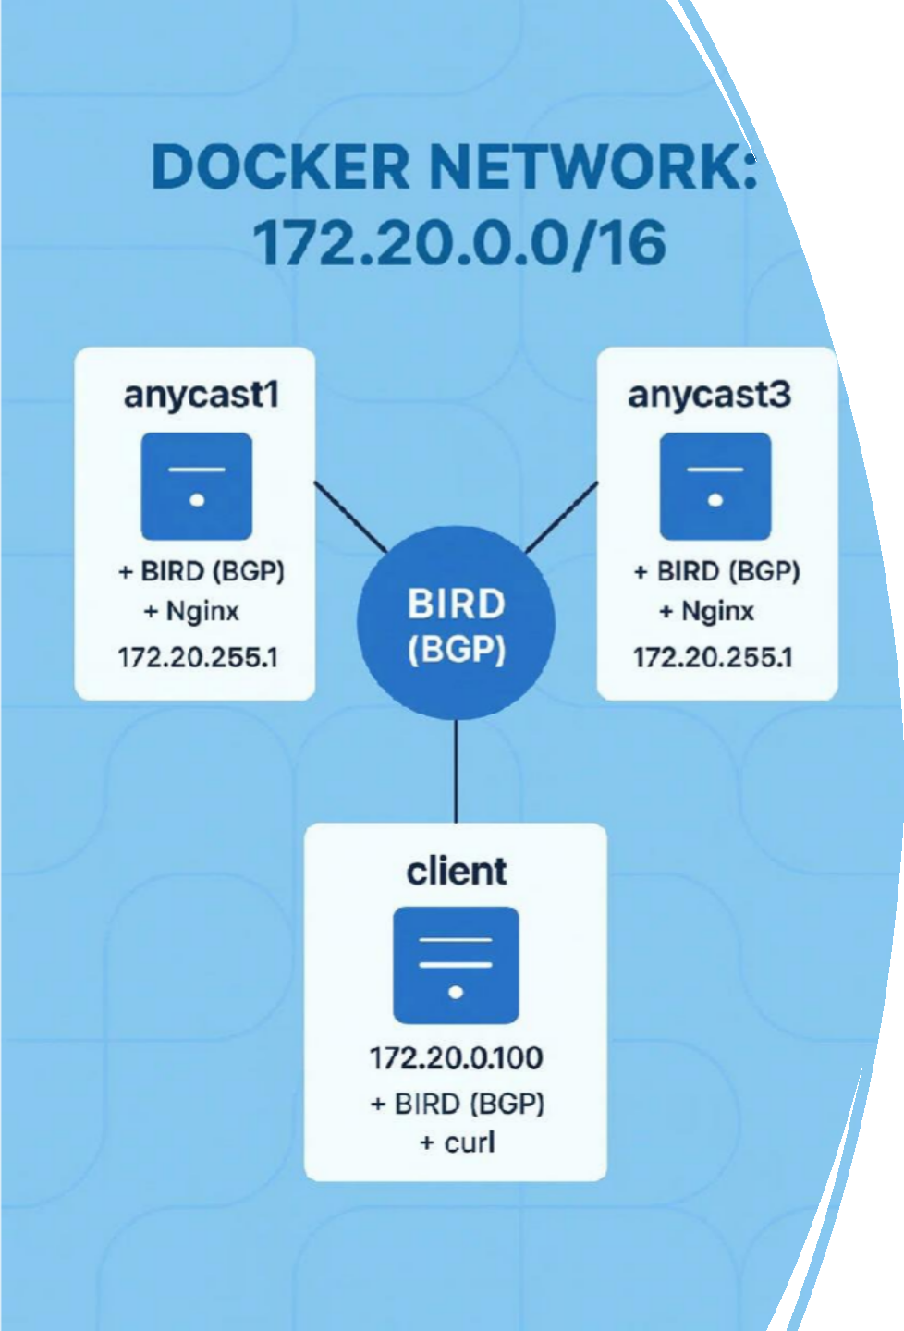
Flip Simulation:
Built a comprehensive simulation lab on Ubuntu VM
Incorporated Docker containers simulated BGP routing(Bird),
This allowed us to test our caching approach under environments that closely mirrored real-world network behaviour

Slide 5
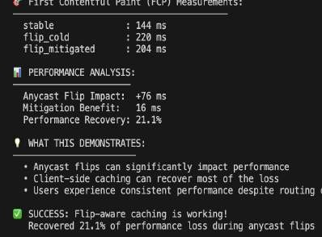
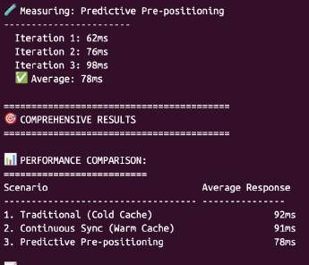
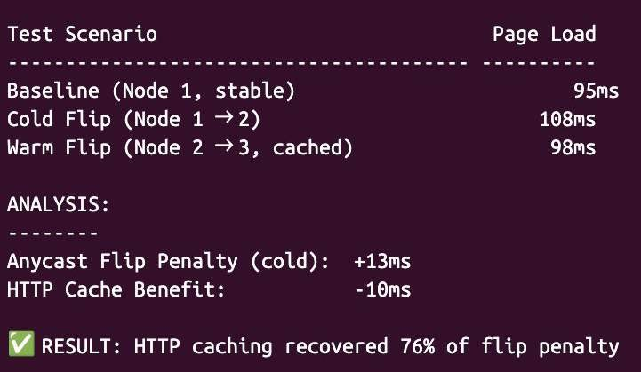
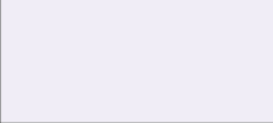
What got done – “Problem Found. Solution. Built”
Success!!
Sprint-1
Did not work out ☹
Sprint-3
We simulated anycast flips in VS Code and implemented our initial caching algorithm
we built a realistic anycast lab with predictive cache pre-positioning, achieving better performance
uilding a Flip anchoring solution – Avoid flips altogether
-But we failed
Upgraded to a full Ubuntu VM lab with Docker and BGP-simulated anycast flips to rigorously test our caching solution.
Sprint-2
Sprint-4
Disappointment follows☹

Slide 6
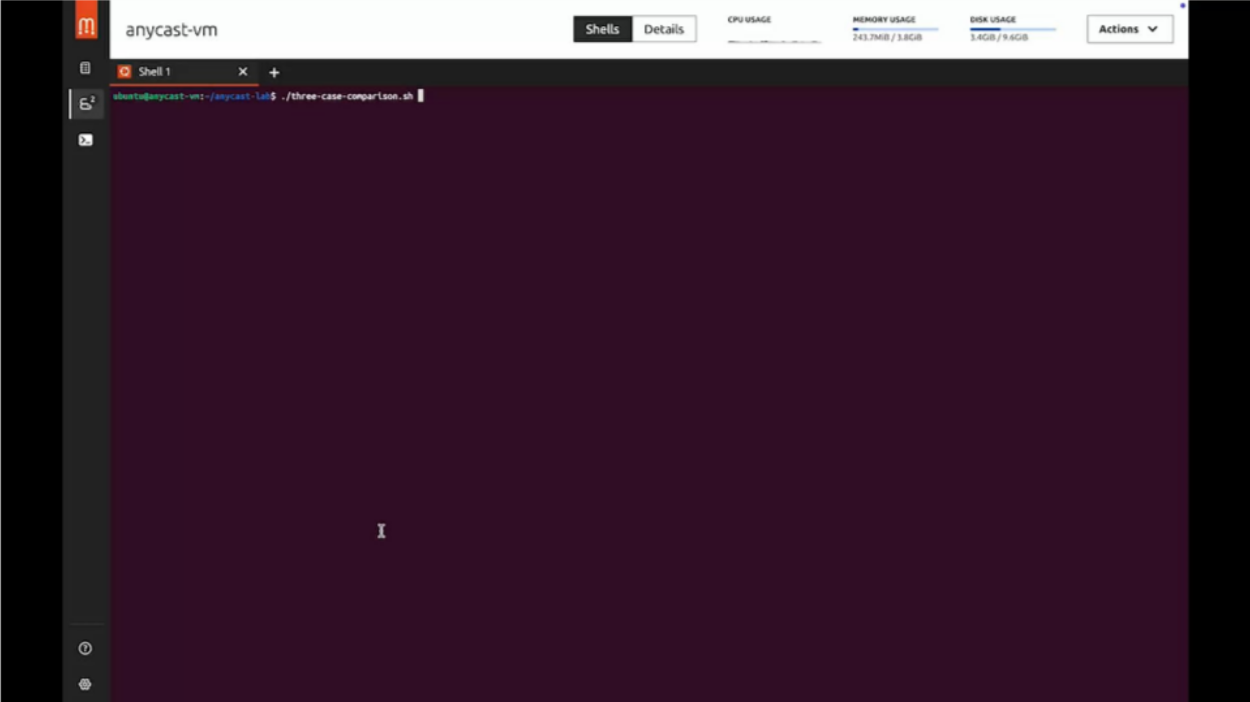
Demo:
Demo

Slide 7
Performance Snapshot-
"Evidence Meets Evaluation"
Test Scenario | Performance Metric | Key Observation | Technical Insight
Traditional Anycast Flip | 120ms average response | 100% performance degradation | Cold cache on surviving nodes causes complete cache miss penalty.
Continuous Sync Approach | 85ms average response | 29% performance recovery | Industry best practice but wastes bandwidth with constant synchronization
Predictive Pre-positioning | 71ms average response | 41% performance recovery | Novel approach - uses BGP signals to warm caches before failures occur
BGP Convergence Time | 8-12 seconds | Network-layer delay | Real BGP route withdrawal and learning process duration
Predictive Warming Overhead | <1 second | Minimal performance cost | Pre-warming occurs during healthy state, invisible to users
7
AIORI-2
Hackathon 2025, Grand Finale

Slide 8
Wrap Up..
Signing off
–Team caffeine coders.
Thank you!!
Team members: Virpratap Singh Ishika Pandey
Dr. Tejaswi Khanna
Contact details:
Virpratap.work@gmail.com
Ishikapandey.2807@gmail.com tkhanna@gn.amity.edu
8
AIORI-2
Hackathon 2025, Grand Finale

