Slide 1

AIORI Standards Hackathon
ByteCoders & NetworkCare
AIORI-2
HACKATHON 2025
GRAND FINALE
12-13 Nov, 2025

Slide 2
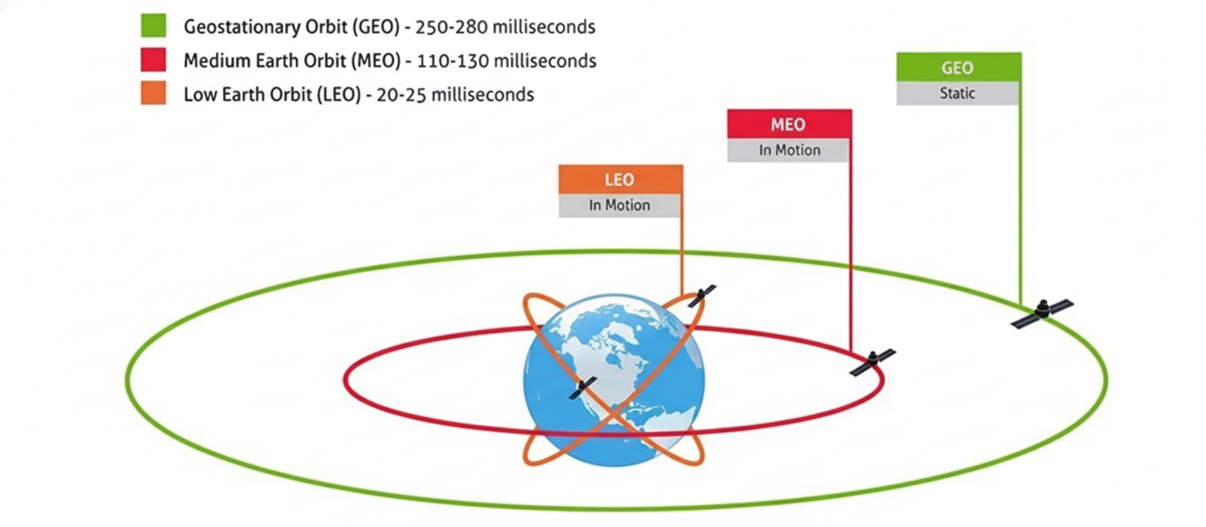
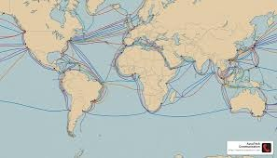
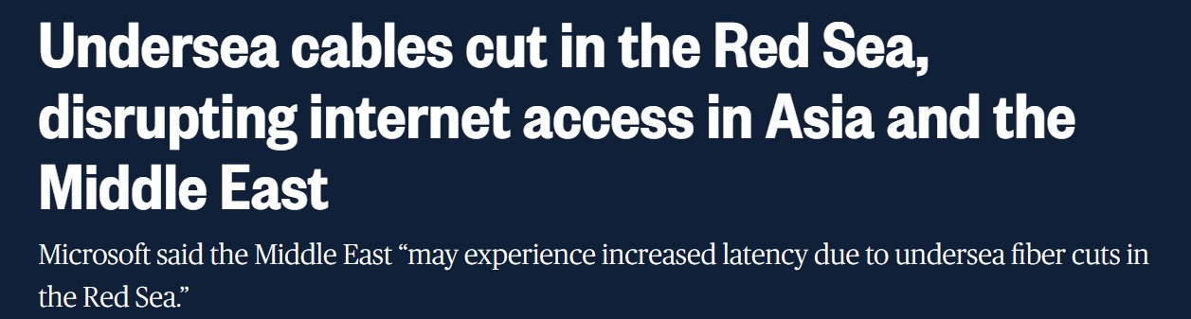
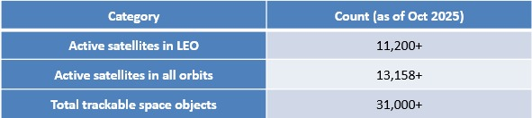
From Static GEO to Agile LEO
GEO Satellites (1980s-2000s)
The Fiber Era (1990s-Present)
Rise of LEO Constellations (2010s-Present)
AIORI-2
Hackathon 2025, Grand Finale

Slide 3
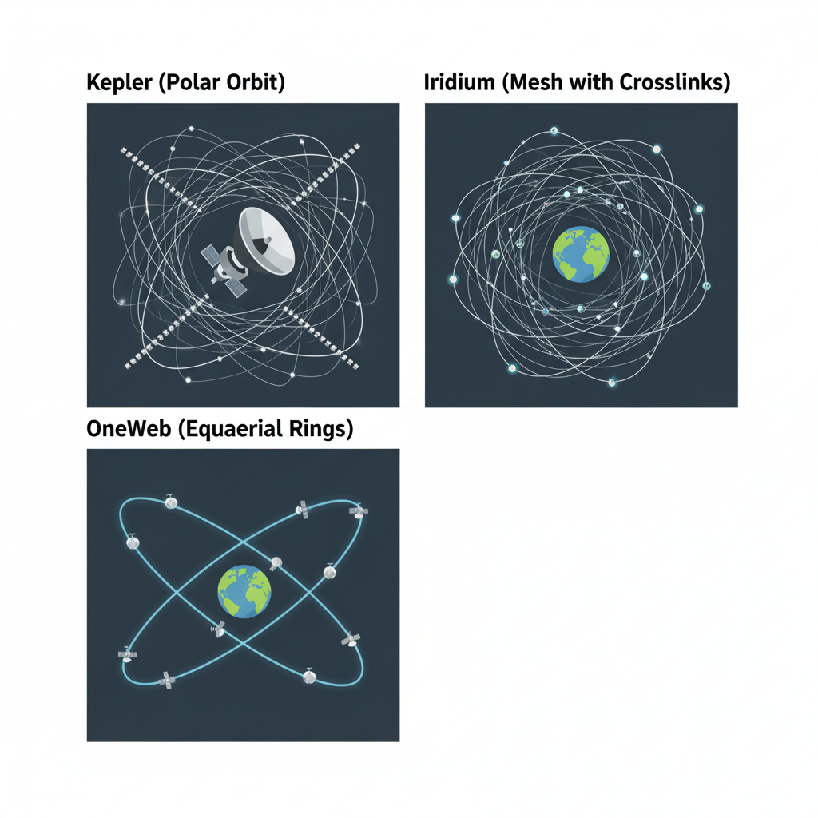
Modern LEO Architectures and RFC 9717
Modern LEO constellations like Kepler, Iridium Next, OneWeb, and Starlink are at the forefront of global connectivity. These systems are designed to offer high-speed, low-latency internet access from space.
RFC 9717, a foundational standard, outlines the use of IS-IS (Intermediate System to Intermediate System) and Segment Routing for managing traffic within these constellations. It assumes a structured, predictable routing environment with stable inter-satellite links (ISLs).
While RFC 9717 builds a robust framework for space routing, its effectiveness hinges on ideal conditions, which are not always present in the dynamic LEO environment.
AIORI-2
Hackathon 2025, Grand Finale

Slide 4
Why Deterministic Routing Fails in Real Space
1. Unpredictable Disruptions
3. Slow Reconvergence
In the real LEO environment, events like optical misalignment, orbital drift, and unexpected outages are common, leading to sudden inter-satellite link (ISL) failures.
Traditional routing protocols like IS-IS and algorithms such as Dijkstra are inherently slow to reconverge after a link failure, causing significant service interruptions and increased latency
2. Lack of Adaptability
Deterministic routing lacks predictive or adaptive capabilities.
It cannot anticipate link issues or dynamically adjust routes in response to real-time changes in the constellation's state.
AIORI-2
Hackathon 2025, Grand Finale

Slide 5
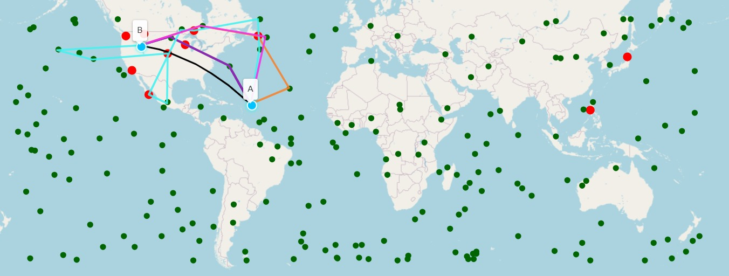
Our Solution: Adaptive Routing with Federated RL
→We explored various routing algorithms, including Dijkstra, A*, Time-Dependent Graph (TDG), Dynamic Time-Expanded Graph (DTEG), and Contact Graph Routing (CGR). Our innovation lies in a Deep Double Q-Network (DDQN) meta-learner that intelligently selects the optimal strategy based on real-time network conditions.
→ This federated reinforcement learning approach involves 8 interconnected ground terminals that share intelligence, creating a robust and adaptive routing system. This distributed learning enables the network to respond swiftly and efficiently to dynamic changes in the LEO environment.

Slide 6
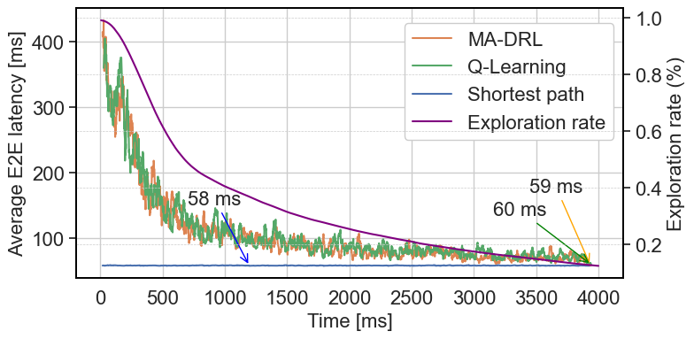
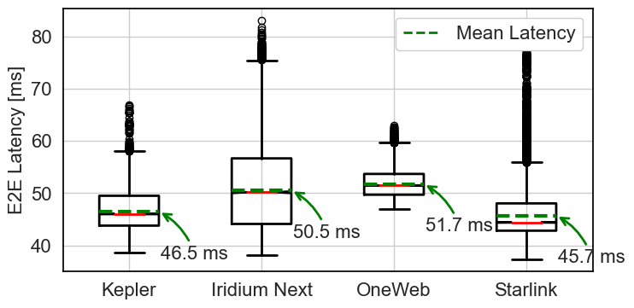
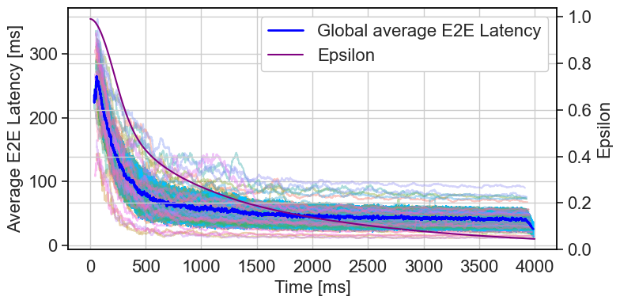
Consistent Low-Latency Performance
Reliable Latency Across Constellations
Achieved an impressive 45-52 ms latency across diverse LEO constellations: Kepler, Iridium, OneWeb, and Starlink.
Ensured instant rerouting capabilities during inter-satellite link (ISL) breaks, maintaining seamless connectivity.
Fig 2.Learning over time
Fig 1. Case study for multiple infrastructures
Fig 3. Decision tree learning over time

Slide 7
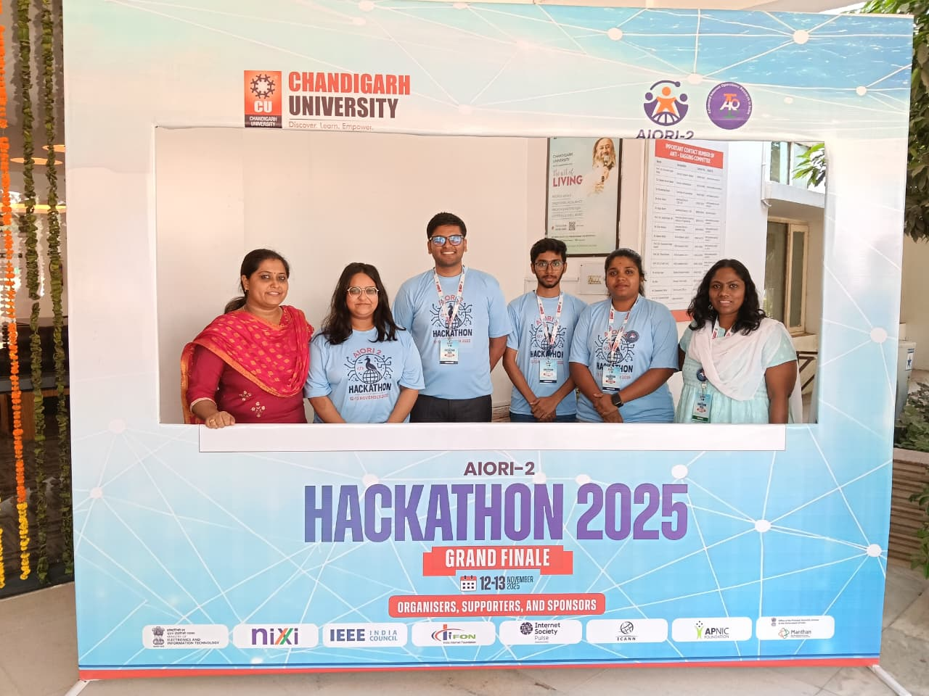
Thank You ! AIORI ,Debraj Dey & Debayan Mukherjee
Team members:
Team Members: Kunwar Utkarsh, Roshita Verma(BYTECODERS) Siddharth K, Priyanka M(Network Care)
Mentors: Electa Alice Jayarani A & Preeti Dubey
GITHUB Repository Link:
Bytecoders_NetworkCare
AIORI-2
Hackathon 2025, Grand Finale

