Slide 1

AIORI Standards Hackathon
Bodhi Bytes
PS-11: QR to Database real time interaction system
AIORI-2
HACKATHON 2025
GRAND FINALE
12-13 Nov, 2025

Slide 2
Hackathon Plan
RFC’s:
RFC 3986 (URI): Governs the URL syntax encoded in the client-side generated QR.
RFC 9110 (HTTP Semantics): Defines the POST (ingestion) and GET (polling) methods for our API.
RFC 9112 (HTTP/1.1): The transport protocol for all client-server communication.
RFC 8259 (JSON): The data interchange format for API serialization/deserialization
Problems to solve :
Overcoming pull-based architectures requiring manual refreshes.
Replacing manual form entry with a zero-interaction scan.
Implementing a mechanism for the dashboard to auto-update.
Plan to solve it:
A frontend dashboard with client-side QR generation (qrcode.min.js) and an asynchronous data-polling mechanism (AJAX).
A stateless RESTful API (Django REST Framework) with defined endpoints for data ingestion (POST) and data retrieval (GET).
Employ high-frequency AJAX Short Polling (setInterval at 2s) to query the GET endpoint, simulating a persistent connection and achieving near real-time data synchronisation.
A relational database backend (MySQL) to ensure data persistence, integrity (via UNIQUE constraints), and transactional logging.
AIORI-2
Hackathon 2025, Grand Finale

Slide 3
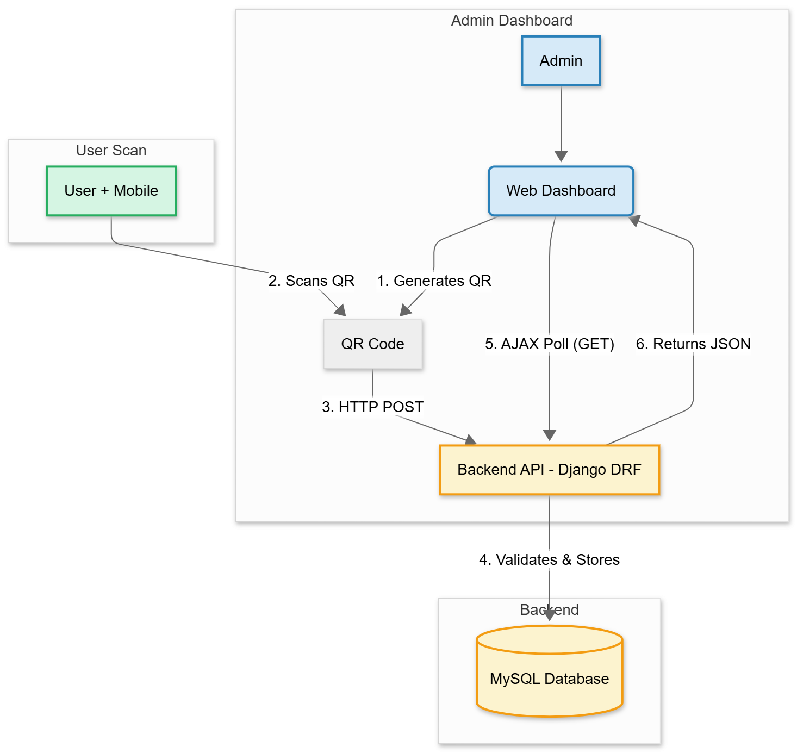
Architectural Flow
AIORI-2
Hackathon 2025, Grand Finale

Slide 4
What got done
ACHIVEMENT (KEY RESULTS):
Deployed a full-stack, end-to-end prototype.
Achieved < 3-second dashboard latency via AJAX polling.
Implemented a secure, idempotent DRF backend (validates & ingests scans).
Integrated a one-click "Export to CSV" module.
NEW IDEA:
AJAX Polling > WebSockets: For this near real-time use case, polling is a simpler, more robust, and horizontally scalable solution.
It avoids the stateful complexity (e.g., Redis dependency) of a WebSocket stack.
GITHUB LINK :
https://github.com/mrunalwaghmare/Team-Bodhi-Bytes-hackthon
NEW DESIGN/ARCHITECTURE:
Extreme architectural simplicity.
Achieved a real-time UX by adhering strictly to core web standards (HTTP, JSON, URI) and a lightweight polling pattern.
Client-agnostic ("app-less") design ensures universal interoperability.
LINK TO RESULTS:
https://drive.google.com/drive/folders/1MzXzK4pShsdESWoAARtgB1TYes73kRMi?usp=sharing
LINK TO VIDEOS:
https://drive.google.com/file/d/1JLX7c_7aYkZxXjD_3hIw4QKqz62Q7PJ1/view?usp=drive_link
AIORI-2
Hackathon 2025, Grand Finale

Slide 5
What we learned
Lessons learned from this hackathon:
Understood real-world use of HTTP standards (RFC 7230–7235, 8259).
Implemented REST APIs with AJAX polling for real-time updates.
Learned JSON structuring and secure OTP handling.
Improved teamwork, debugging, and integration under pressure.
Issues with existing drafts/RFCs:
HTTP (RFC 9110–9112) lacks real-time data handling guidance.
JSON (RFC 8259) doesn’t support live/streaming updates.
SMTP (RFC 5321) unsuitable for quick OTP verification flows.
Existing RFCs focus on request–response, not real-time communication.
New implementation guidance:
Use AJAX polling for near real-time dashboard updates.
Add asynchronous email handling for faster OTP delivery.
AIORI-2
Hackathon 2025, Grand Finale

Slide 6
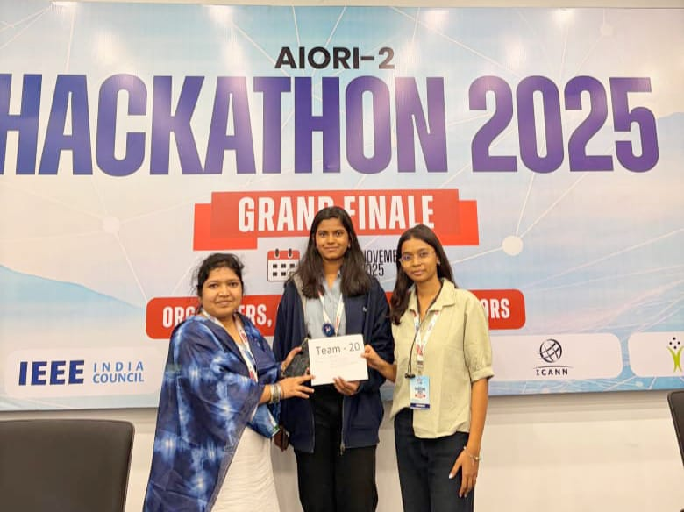
Wrap Up
Team members:
- Harshada Bhujbal
- Mrunal Waghmare
- Bhagyashri Thorat (Mentor)
https://github.com/mrunalwaghmare/Team-Bodhi-Bytes-hackthon
www.linkedin.com/in/harshada-bhujbal
www.linkedin.com/in/bhagyashri-thorat-44725115
https://www.linkedin.com/in/mrunal-waghmare-150476255/
AIORI-2
Hackathon 2025, Grand Finale

